Slide 1
NRULPC Advisory Board Meeting
April 29, 2019; 9:00 am – 4:00 pm

Slide 2
Welcome, Introductions, Review Agenda - Joe Willis, Advisory Board Chair & Andy Groseta, Advisory Board Vice-Chair
Purpose:
“To update Advisory Board on Center & Clinic activities and discuss Engagement Strategies”

Slide 3
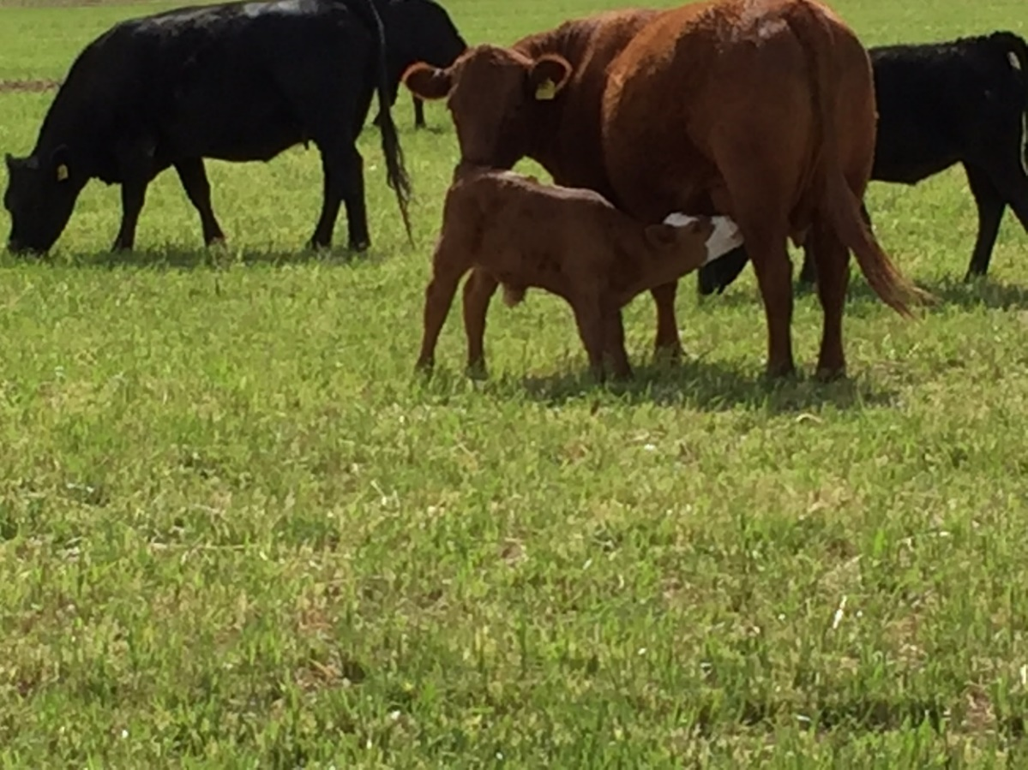
Overview of NRULPC Progress - George Ruyle & John Lacy, Co-Directors
The Center is about helping landowners, farmers and ranchers in Arizona solve their legal and regulatory hurdles to using the land.

Slide 4
2018 Projects for Center
Rx burning liability issues (developed a legal framework for the use of prescribed fires by private landowners)
Yuma Island land and water status
Labor shortage crisis in dairy industry (TN Visas for Dairy Technicians, case law review)

Slide 5
2018 Projects for Center
Agency for Toxic Substances and Disease Registry (ATSDR) jurisdiction over confined animal agriculture
Advised landowners in the Gila River Valley about their legal options to optimize the use of their water
Researched memorandum on the status of open range laws

Slide 6
Current Projects for Center
NEPA tutorial and handbook to help Extension agents best serve user interactions with federal agencies in getting projects authorized
Developing process for mediation for grazing allotment disputes
Assessment and allocation of vacant grazing allotments
Analysis of CNF-BA for livestock grazing program
Analyses of new WOTUS rule

Slide 7
Mining Law Center - Providing On-Line Master’s Degree Programs in Domestic and International Natural Resource Law
LLM: 24 units for graduate lawyers
MLS (Master of Legal Studies): 30 units for graduate natural resource and mining professionals
Non-credit executive training on mining and public land law subjects
Providing course options for law students in natural resource related subjects
John Lacy has been at this for a long time!

Slide 8
Current Projects of the Center – On-line Training
Background (technical or legal)
Basic mining law (domestic and international)
Acquisition issues
Global taxation
Environmental law
Sustainability/Engagement

Slide 9
Current Projects of the Center - Online Training
Course on Developing Public Lands Under the National Environmental Policy Act
Course on Public Land Use
Available to students in the Clinic, students in CALS and as executive training
Video postings of lectures and interviews on current topics
Colorado River conservation
Waters of the United States

Slide 10
Outline of On-Line Natural Resource Presentations

Slide 11
On-line interviews - Forest Products

Slide 12
Clinic Activities - Bethany Sullivan, Clinic Director
6 JD students currently enrolled in Spring 2019
8 JD students have enrolled for Fall 2019
Additionally, 1 JD student doing a hybrid externship/clinic enrollment over Summer 2019 with Idaho Forest Group
*Student internships a great way to get students into field; if have ideas for possible internships, can work with Clinic and Center to circulate to students and facilitate.

Slide 13
Clinic Structure
Weekly seminars: students meet in classroom, lessons on substantive law, project rounds, student presentations, guest lecturers, exercises
Individual projects: students work alone or in groups on projects for the NRULPC, Cooperative Extension, tribes, and other client organizations.
Weekly individual meetings with Director, in addition to meetings with NRULPC, clients, and University experts.

Slide 14
Example Clinic Projects
Waters of the United States project
How proposed rule will change permitting on the ground in Arizona
Several students involved; researching how WOTUS evolved over time, comparing old rules to new proposed rule, analyzing how Arizona has or will assume CWA programs
Watershed restoration/land improvement project
Hot topics blog
Administrative Appeals Handbook
NEPA Handbook
Guest teaching in rangeland management course

Slide 15
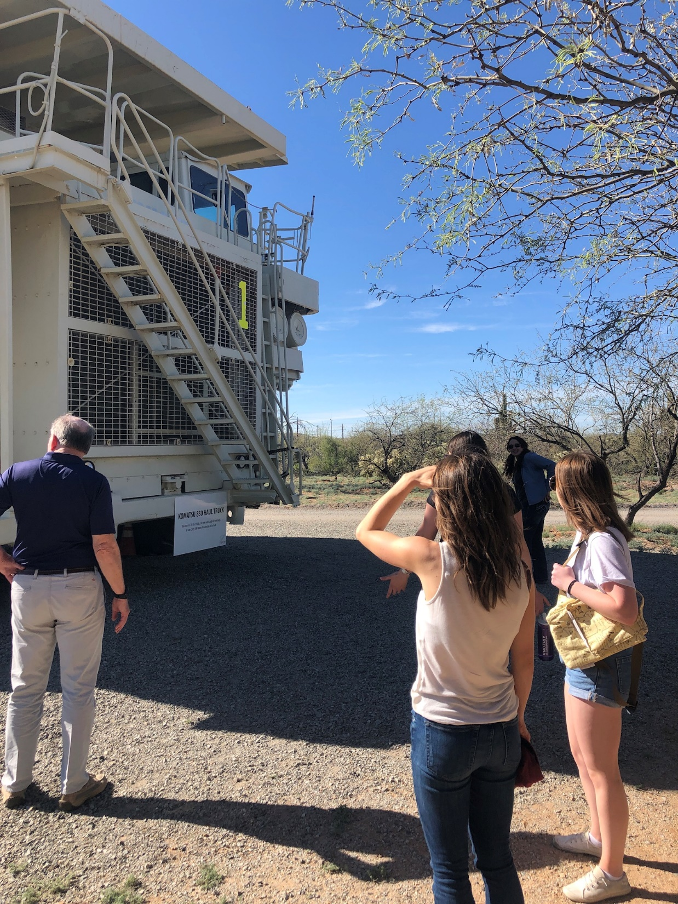
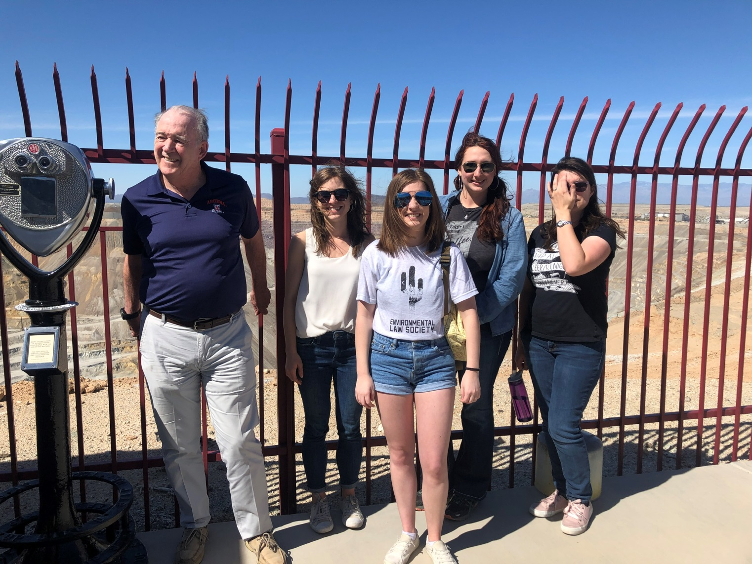
Outside the Classroom – Tour of Asarco Mission Mine with special guest, Professor John Lacy

Slide 16
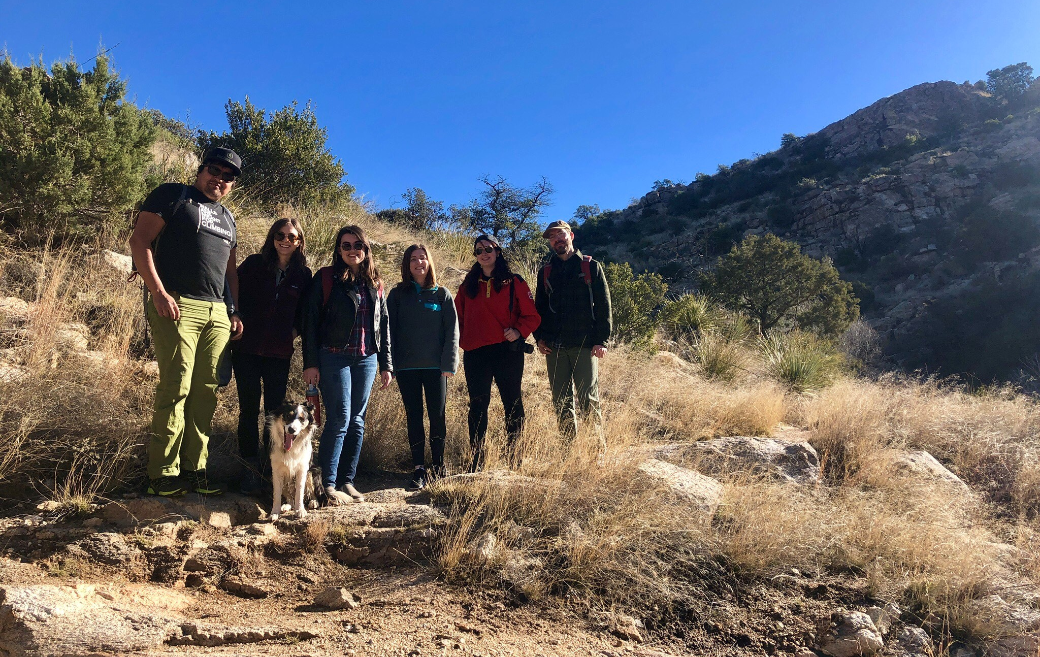
Outside the Classroom – Mt. Lemmon hike with special guest, Professor Len Necefer

Slide 17
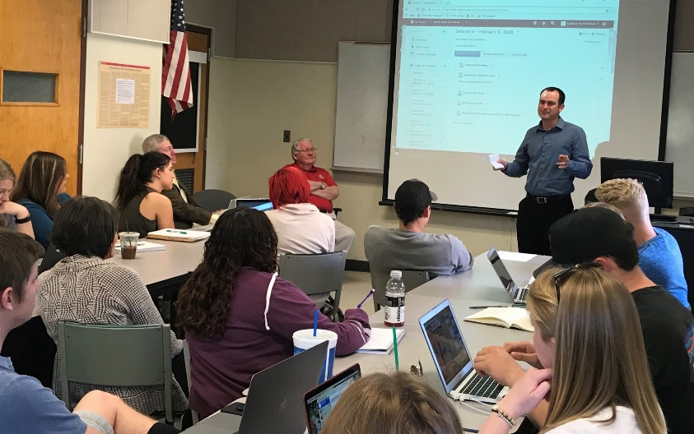
Course Update - ACBS/Law 411 Joint Course - Joe Willis & Celeste Steen
“An introduction to Agricultural Law and Policy for the Modern Day Natural Resource User”
First class of its kind for undergraduates
Co-taught by Celeste Steen, Esq. and Joe Willis, Esq.
Overall purpose to promote law as a career option to students working on degrees associated with natural resource use

Slide 18
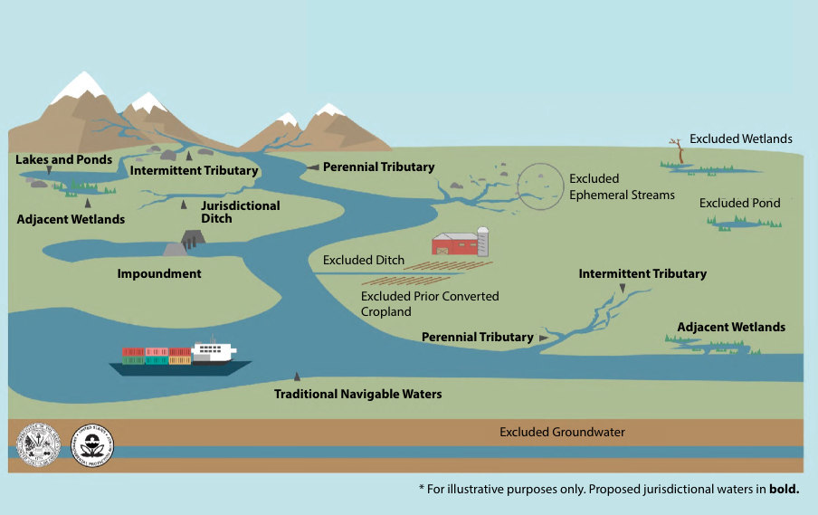
WOTUS Project – 2019 Proposed Rule

Slide 19
Advisory Board Member Presentations and Q&A
Dairy workers/technicians visa update – Ashley Ellixson, JD
Ag water issues/Drought Contingency Plan – Stefanie Smallhouse, Carlink Ranch; President, Arizona Farm Bureau Federation

Slide 20
Keynote Speaker -
Bill Myers
Partner at Holland & Hart, specializing in energy, natural resources, and public land law; Boise, ID
Presentation Abstract: Presidents have used their authority 20 times since the passage of the Antiquities Act in 1906 to diminish national monuments. Not until December of 2017 when President Trump invoked the Act to diminish the size of President Clinton’s Grand Staircase Escalante National Monument and President Obama’s Bears Ears National Monument has the presidential power to diminish a National Monument been challenged in court. Within hours of the President’s proclamations, five lawsuits were filed in federal court seeking to undo his actions. Mr. Myers will discuss the interesting procedural and substantive issues in the cases from his perspective as counsel to intervenor defendants. His perspective is informed by his law practice both as a senior governmental attorney and as a practitioner in private practice.

Slide 21
Budget and Funding Development
Marc Miller, Dean - UA James E. Rogers College of Law
Megan O’Leary, Development Officer - UA James E. Rogers College of Law
Jeff Menges, Advisory Board Member

Slide 22
Advisory Board Expertise Directory & Proposal for AB Newsletter Column - Barbara Hutchinson & Sheila Merrigan
Background:
Allow for ongoing Advisory Board contributions & input
Content: litigation status? issues in news? key state and federal policy issues?
Action: Review expertise directory list and update/edit as needed.
Update areas of interest and expertise (speakers & projects)
Update contact information
Bios, resumes & photo
Action: Determine interest in an AB Newsletter column (discuss)

Slide 23
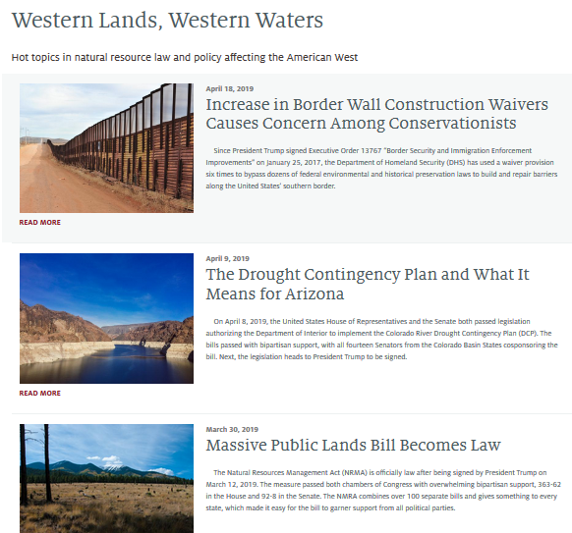
Blog - Bethany Sullivan & Allie Whitehill, Clinic Student
https://westernlandsblog.arizona.edu/

Slide 24
Small Group Discussion - Barbara Hutchinson
Choose One Group
Proposal to hold symposium: “Using Science in Law” (fall 2019) – Joe Willis, Moderator
In your experience, how has science impacted you or others you know?
What are examples of how it been used or misused?
How has it influenced litigations in natural resource issues?
Funding discussion – Jeff Menges, Moderator

Slide 25
Small Group Reports - Barbara Hutchinson
Symposium Discussion:
Funding discussion:

Slide 26
WE VALUE YOU!
Wrap up
Thank you
Adjourn
THANK YOU FOR YOUR COMMITMENT TO THE NRULPC and CLINIC!

