Slide 1
Playing the Long Game
Natural Resource Users Law and Policy Center
Dr. Ethan Orr
Associate Director Agriculture, Natural Resources and Economic Development
Associate Specialist, Community and Economic Development

Slide 2
Legislative Success
Extension Received $55.7 Million over the next 3 years
$7.4 Million for Extension, 3 years ($22.2 Million)
$1.5 Million NRULPC ($1 Million ongoing / $.5 Million one time)
$30 Million – Water Irrigation Grant
  $3 million IDC / $3 Million Extension Costs /
  $1 Million for Research/Testing on Arizona Experiment Centers
Additional Land Grant Support (Over $44 million for three years)

Slide 3
Types of Funding from the Legislature
Baseline
Large Special Projects
Directed Money

Slide 4
Extension Funding over the Past Decade
2014 - $3.5 Million for Extension (32.7% increase)
2021 $1 Agriculture Apprentice / $1.5 Million NULPC
2022 – $ 7.4 Million for Extension (52.1% Increase)

Slide 5
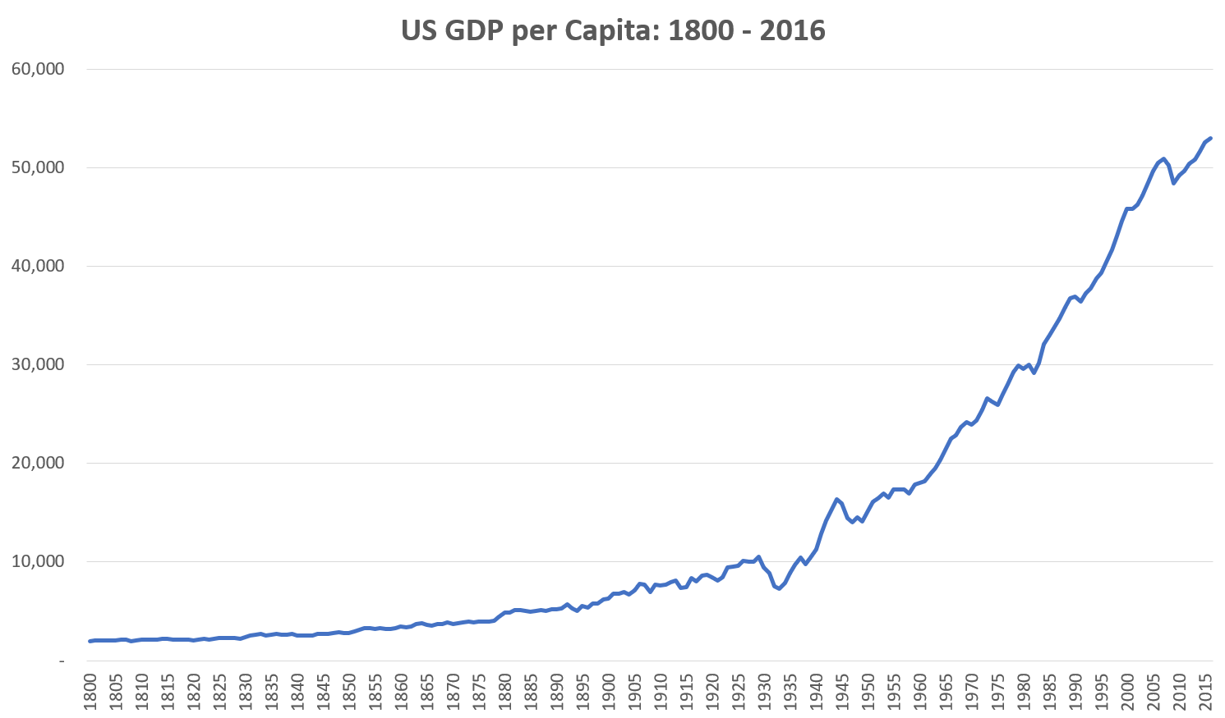
What were the Results
Economic Growth in America

Slide 7


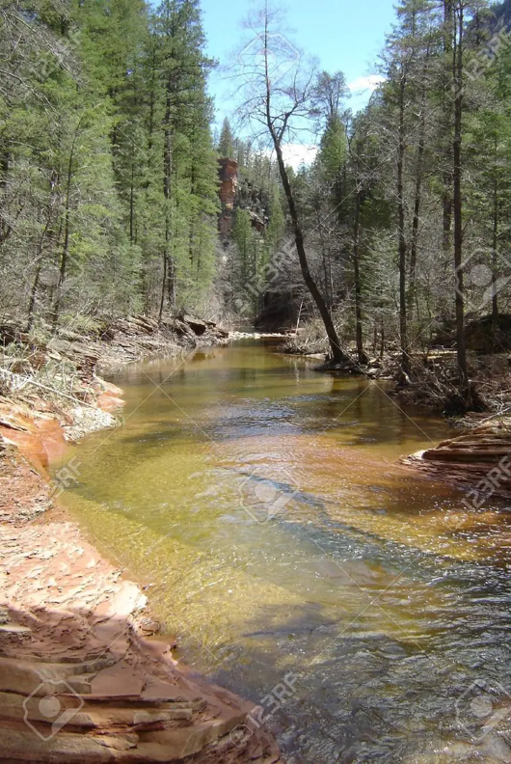
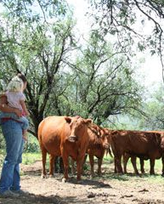
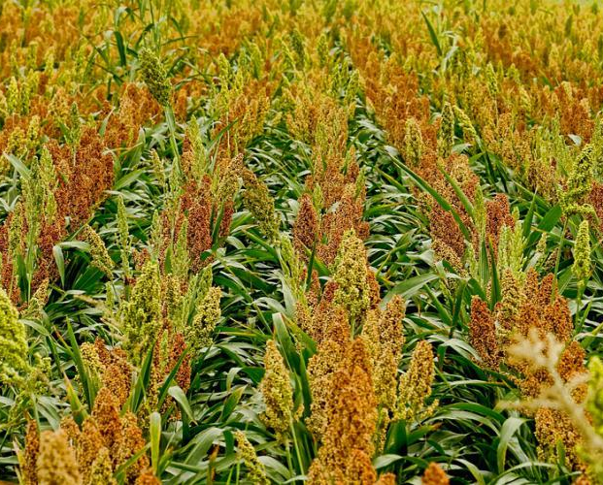
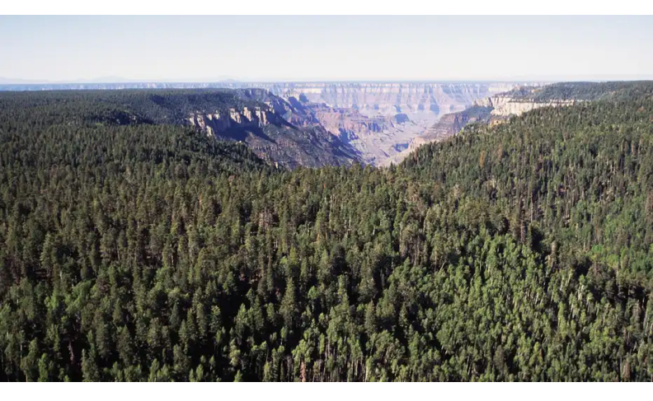
We Stand on the Shoulders of Giants
Over 100 Years of serving our state

Slide 8
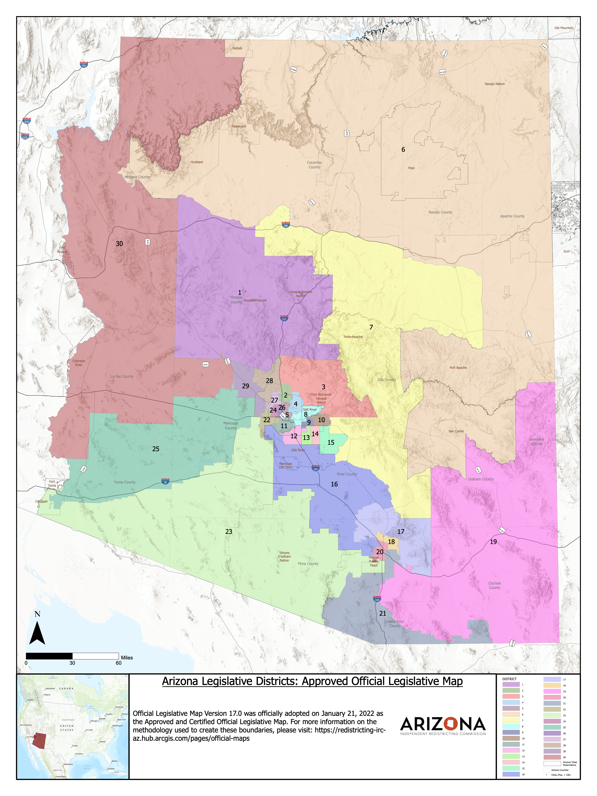
Political Power
Traditional Leadership Districts (2012-2020)
Yavapai
Cochise / Graham
East Valley
Urban and Rural (2022-2030 Districts)
Phoenix (15 districts)
Tucson (3 Districts)
Sun Corridor (Touches 27 Districts)

Slide 9
Politics is a Team Sport (We are a Team)
Every Member Every District (Every Person)
Part of the Community and Part of the Solution
We are the trusted source
Advancing Education and Innovation in Arizona

Slide 10

Thank you
Dr. Ethan Orr – eorr@arizona.edu

