Slide 1
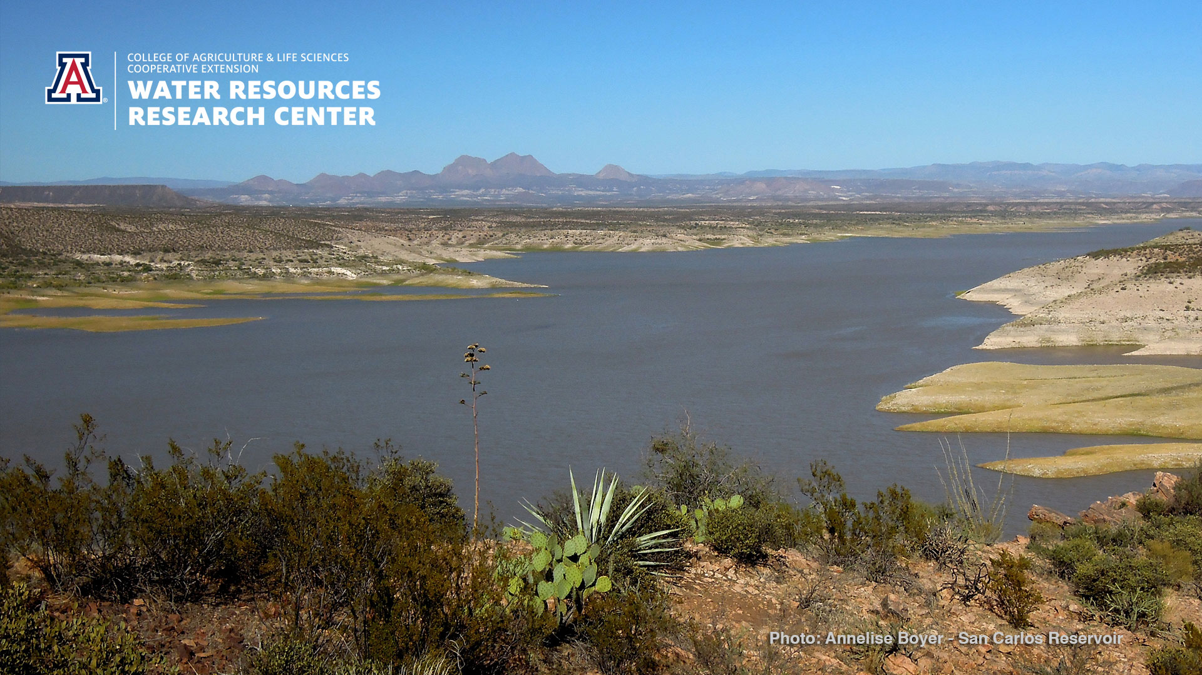

Water Updates, Collaboration Opportunities, and Q&A with the Water Resources Research Center
Sharon B. Megdal, Director, and the WRRC Team
Annual Cooperative Extension Conference
October 6, 2020
smegdal@arizona.edu
wrrc.arizona.edu

Slide 2
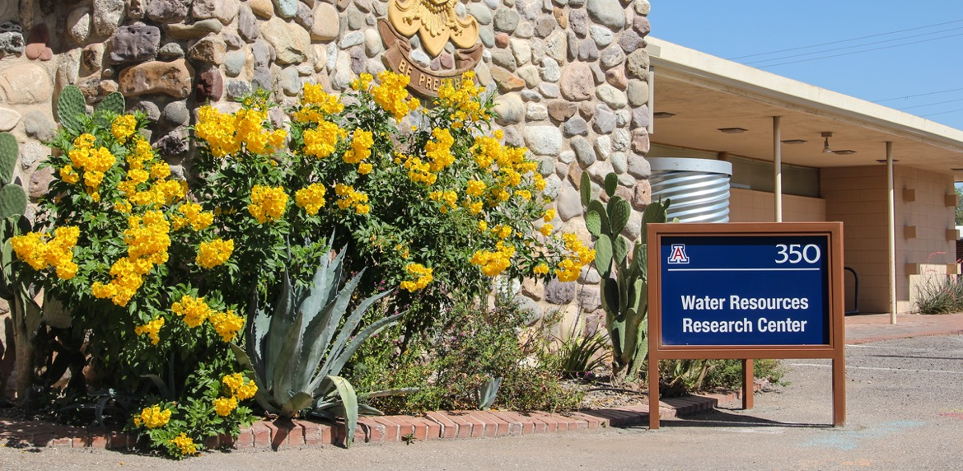
GREATER DEPTH, BROADER PERSPECTIVE
FOR A CLEAR WATER FUTURE
We tackle key water policy and management issues, empower informed decision-making,
and enrich understanding through engagement, education, and applied research.
wrrc.arizona.edu
wrrc.arizona.edu/subscribe

Slide 3
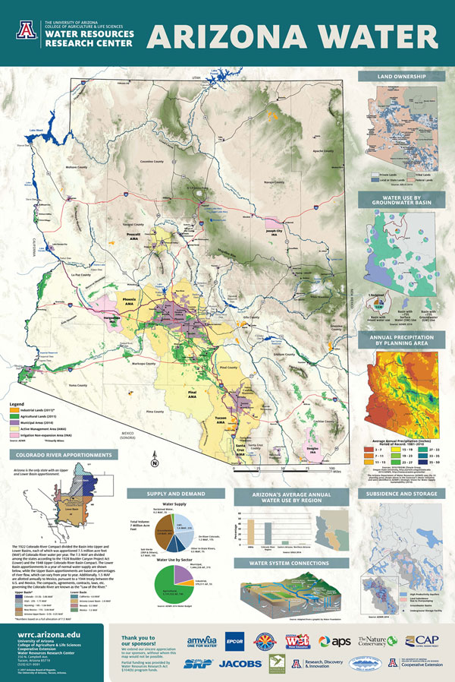
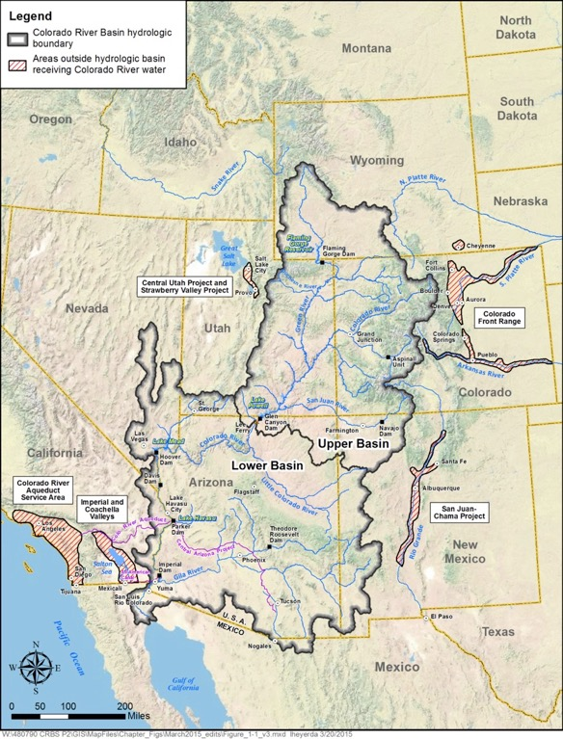
UPDATES

Slide 4
COLLABORATION OPPORTUNITIES

Slide 5
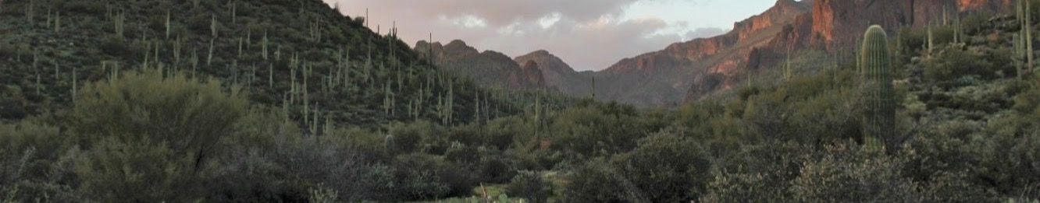
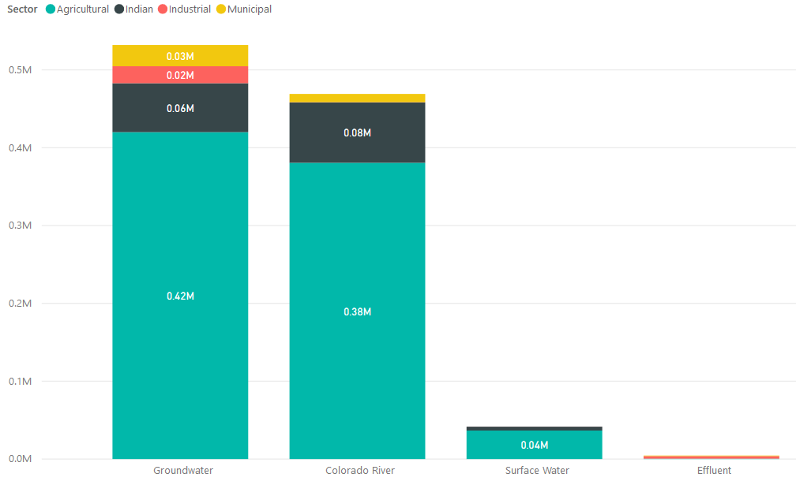
Know About Your Water – Basic County Level Water Resource Information
A Water Resources Research Center program to build collaborations with Arizona’s County Cooperative Extension offices to grow awareness and understanding about water in each county
Survey: CES directors in 2018 indicated how the WRRC could help achieve county CE goals.
Assistance with seminars & speakers
Fact sheets
Finding project funding
Connecting with UArizona researchers
County-relevant Information:
    Water Sources
    Water Quality
    Water Use
    Water Infrastructure
    Water Issues
Data: WRRC staff has experience acquiring and synthesizing relevant water data from multiple sources.
Example: for Maricopa County, WRRC helped organize 3 seminars, hosted by Maricopa County CES, and provided the keynote presentation.
Water use in the Pinal AMA
https://new.azwater.gov/ama/ama-data
For more information or to discuss collaboration, contact Susanna Eden at seden@arizona.edu
Arsenic in Arizona Water
Groundwater Quality in Arizona (1995-2009). Arizona Department of Environmental Quality, 2011.

Slide 6
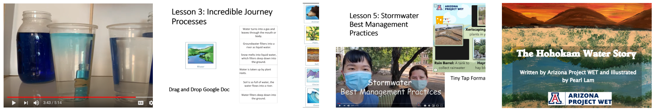
Arizona Project WET
Current focus is the online Activation of Learning
Video demonstrations bring phenomena to life for students studying matter and energy. They discover that heat energy from the sun drives the water cycle.
Googles slides offer opportunities to make small group work interactive using a drag and drop process to study water movement and transformation in the water cycle.
Touring the UArizona campus, Miriam and Pearl bring a new aspect to the curriculum and add to the learning using a formative assessment in Tiny Tap.
Arizona Project WET's first storybook brings historical and cultural perspective to the understanding of Tucson's water resources and use.

Slide 7



Water RAPIDS Program
Ashley Hullinger, Program Lead
Helping communities balance a secure water future
for residential, commercial, industrial, and agricultural sectors, and the
natural environment.
Working with stakeholders in southern Gila County since 2015
to develop local solutions to unique rural challenges.
wrrc.arizona.edu/waterrapids

Slide 8
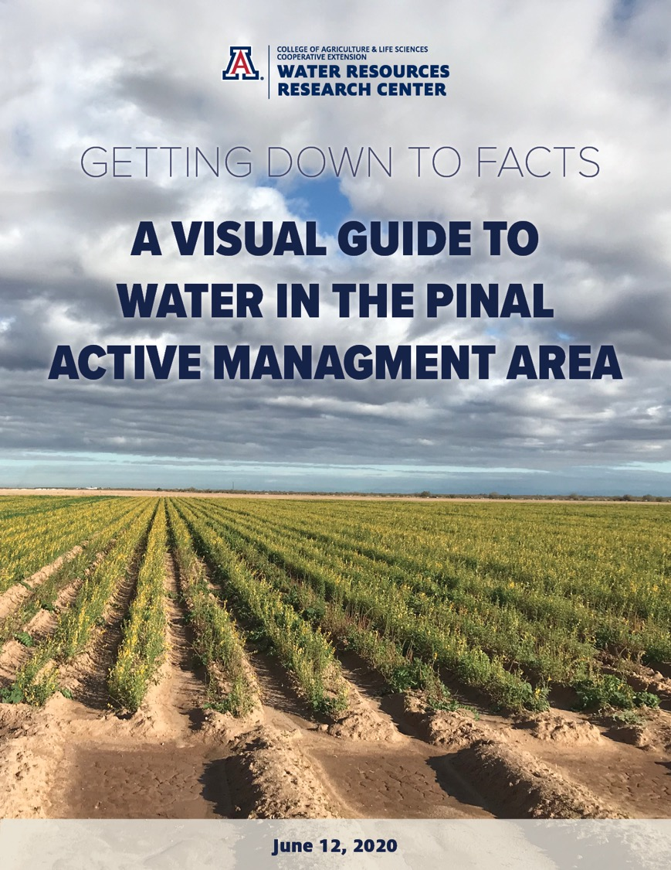
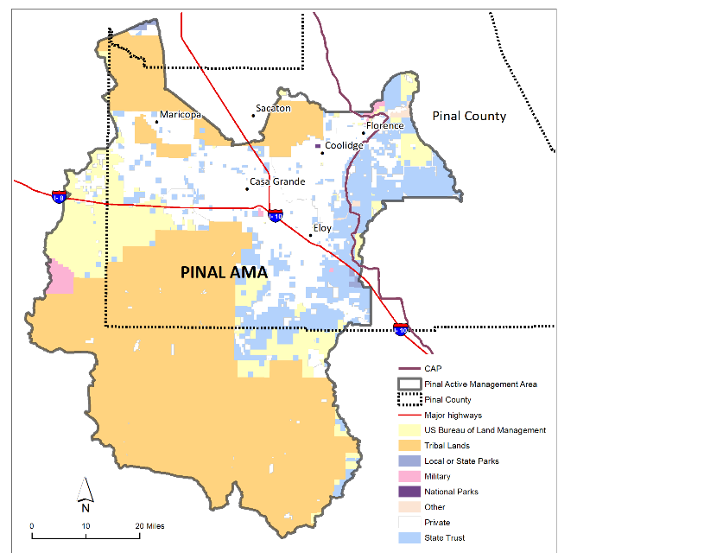
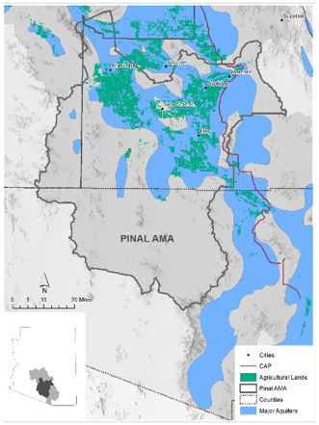
Making data accessible for local water resources planning in rural Arizona
Intended for interested residents, decision makers, and other stakeholders seeking to understand the big picture of water issues in the Pinal AMA. Funded by Babbitt Center for Land and Water Policy.
https://wrrc.arizona.edu/news/visual-guide-water-pinal-active-management-area
Page 6

Slide 9

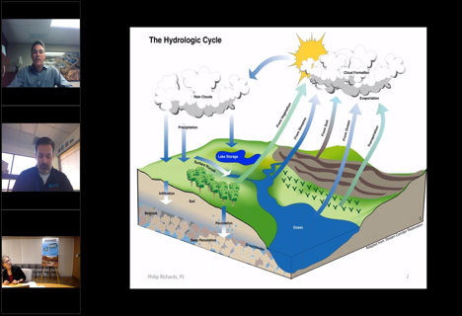
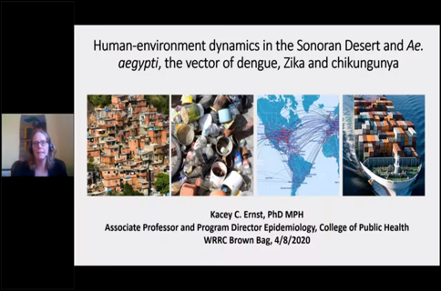
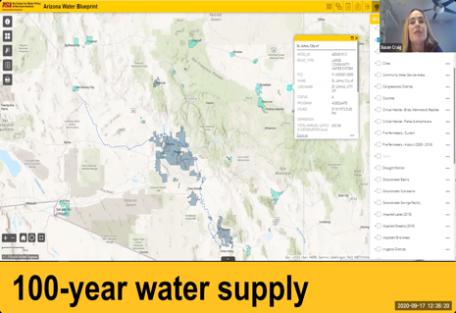
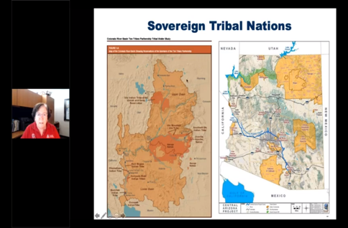
WRRC Brown Bag Webinars
Now fully virtual, the Brown Bag Webinar series feature fascinating presentations on water, no matter where you are!
A real thirst for water information:
Since March, webinar attendance has more than doubled!
Visit our website for upcoming webinars and an extensive library of recorded presentations dating back to 2013!
wrrc.arizona.edu/brown-bag-seminars
Michael Seronde – seronde@arizona.edu

Slide 10
WRRC Annual Conferences
2020
2019

Slide 11
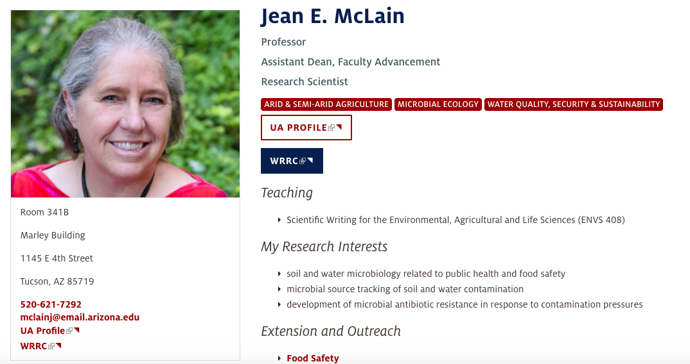
Water Quality Research

Slide 12
Sharon Megdal applied research and other programs
Water policy and management
  Groundwater
  Managed aquifer recharge
  Colorado River Basin
  US-MX transboundary aquifers
  Comparative analysis – Israel and Jordan
Indigenous Water Dialogues
Presentations
Publications, including Reflections series
Spring semester 3-unit course, ENVS 596B, Water Policy in Arizona and Semi-arid Regions
wrrc.arizona.edu/director
wrrc.arizona.edu
wrrc.arizona.edu/subscribe

Slide 13
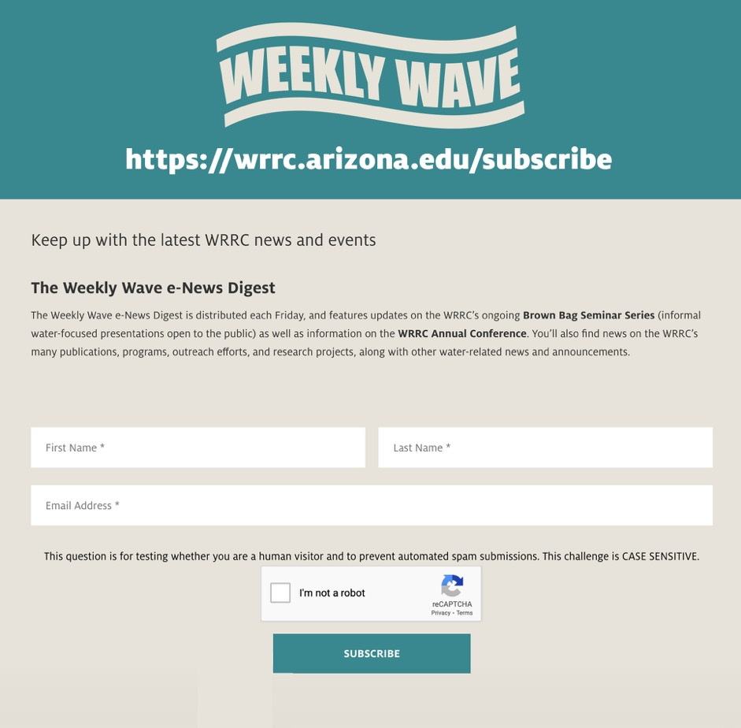

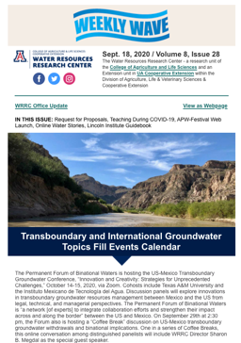
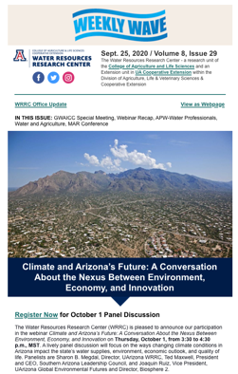
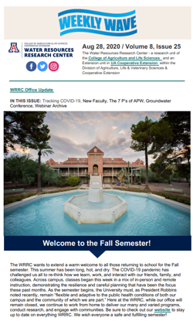


The Weekly Wave
wrrc.arizona.edu/subscribe
twitter.com/azwrrc
Stay Informed
Subscribe to keep up with our news and events.
facebook.com/AZWRRC
instagram.com/uazwrrc
Web site: wrrc.arizona.edu
John Polle – jpolle@arizona.edu

Slide 14
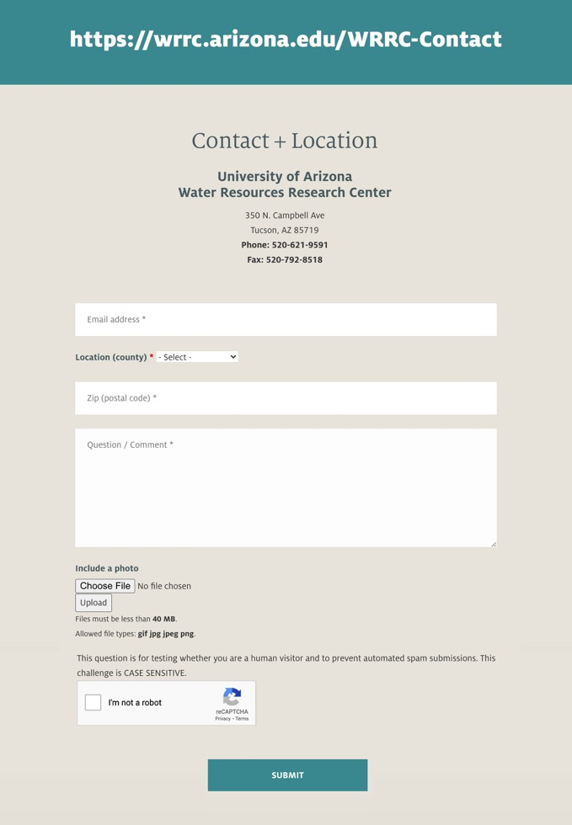
WRRC Contact Form
Q&A - Discussion
We are here to help answer your
questions about water in Arizona
The WRRC contact form is now linked to Cooperative Extension’s customer relationship management (CRM) system, allowing us to better track and respond to inquiries from throughout Arizona. Personnel from the WRRC will respond to questions submitted through our web form within 3-5 working days (usually much sooner), helping provide answers to water-related questions that impact our state.
wrrc.arizona.edu/WRRC-Contact

