Slide 1
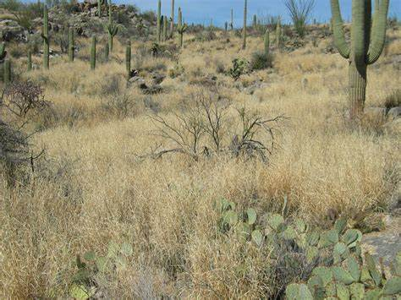

Slide 2
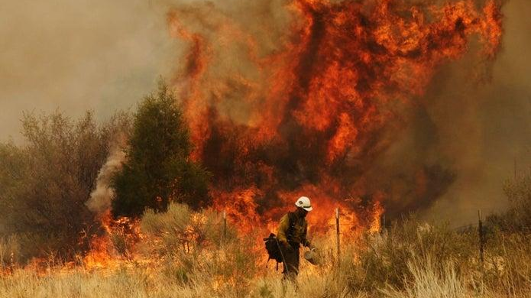

Slide 3
AGENCY | ARIZONA FIRES | ARIZONA ACRES
Arizona State Forestry | 330 | 55775
New Mexico State Forestry
Bureau of Indian Affairs | 851 | 194286
Bureau of Land Management | 164 | 25104
Bureau of Reclamation
Department of Defense
National Labs
National Park Service | 17 | 780
U.S. Fish & Wildlife Service | 11 | 1810
U.S. Forest Service | 729 | 586059
YTD TOTAL 09/30/20 | 2136 | 914235

Slide 4
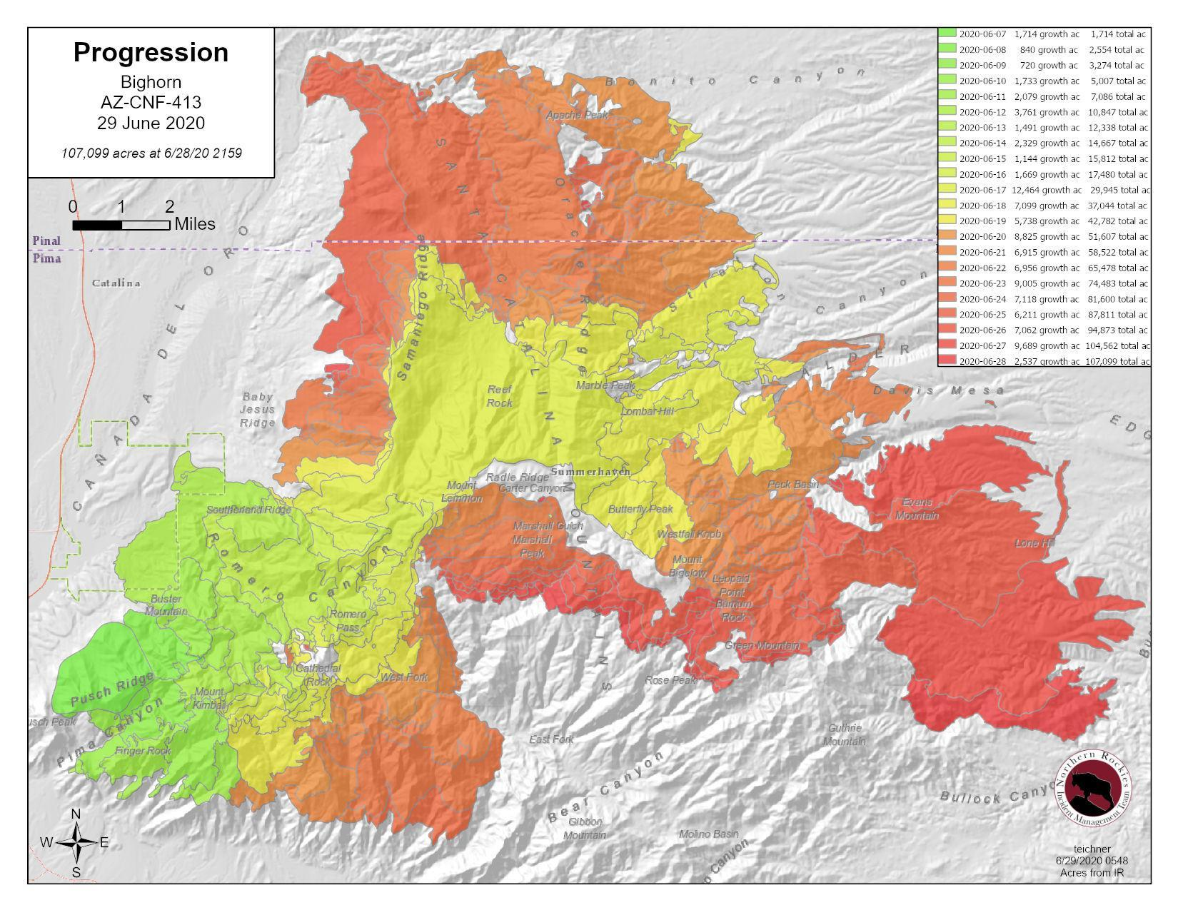

Slide 5
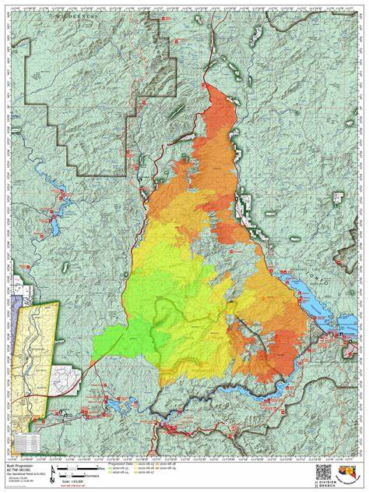

Slide 6
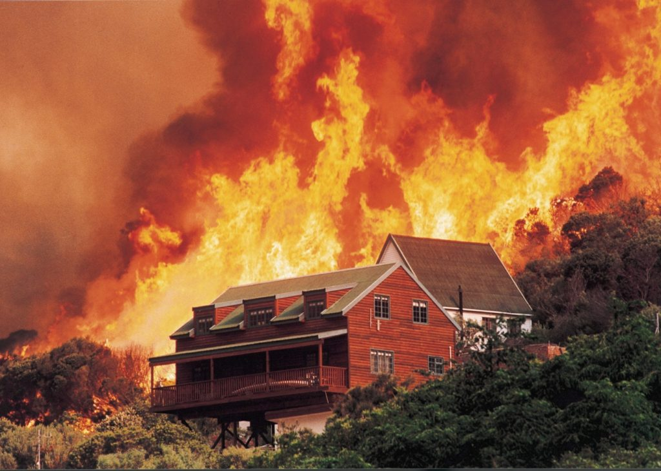

Slide 7
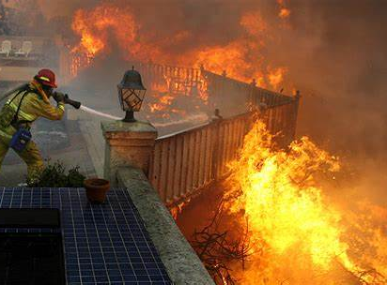

Slide 8
