Slide 1
Library resources & Services for Az Cooperative Extension
Jeanne L. Pfander, Associate Librarian
Liaison to ALVSCE, University of Arizona Libraries
jpfander@arizona.edu

Slide 2
Overview of Today’s Session
People Resources
Information Resources
Services
Policies

Slide 3
BUT FIRST...
What questions do you have about the University Libraries?
[Please respond in Chat.]

Slide 4
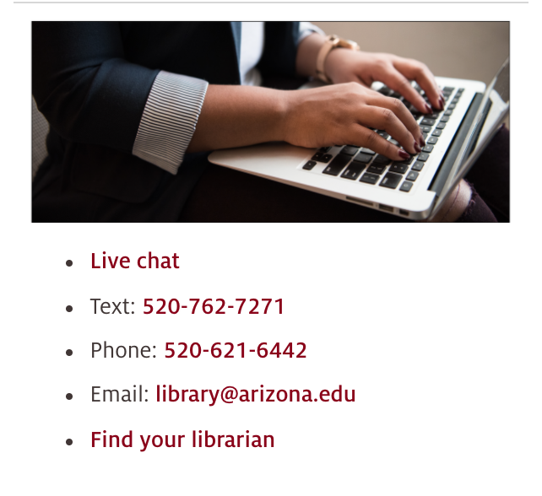
NEED HELP? ASK US!
https://libguides.library.arizona.edu/faq
Notes:
https://libguides.library.arizona.edu/faq

Slide 5
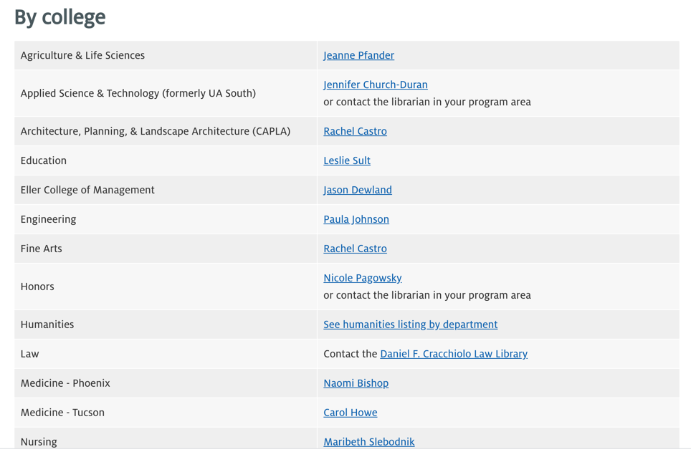
FIND YOUR LIBRARIAN
https://new.library.arizona.edu/about/contact/your-librarian
Notes:
https://new.library.arizona.edu/about/contact/your-librarian

Slide 6
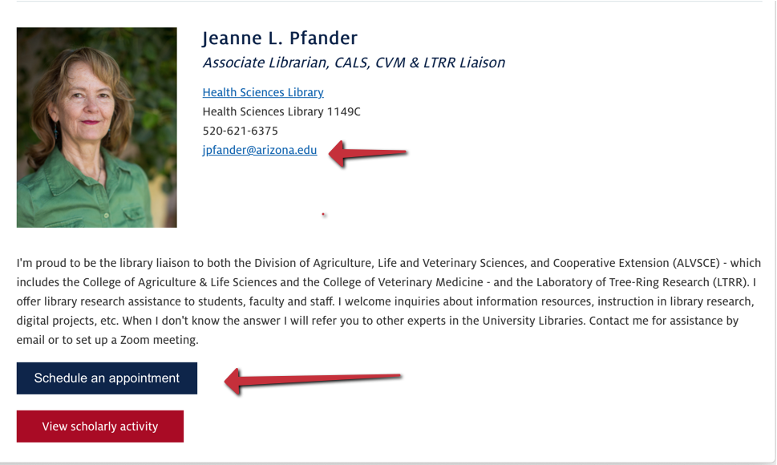
https://new.library.arizona.edu/people/jeanne-l-pfander
Notes:
https://new.library.arizona.edu/people/jeanne-l-pfander

Slide 7
SPECIALISTS
Campus Repository Services – Kimberly Chapman
Data Curation – Chris Kollen
Data Science – Jeffrey Oliver
Geospatial Info – Kiri Carini
Research Data Management – Fernando Rios
Scholarly Communication– Ellen Dubinsky
Office of Digital Innovation & Stewardship
See also CATalyst Studios for makerspace technology specialists
Notes:
https://repository.arizona.edu
https://new.library.arizona.edu/catalyst

Slide 8
SUBJECT GUIDES
Agriculture
Animal Science
Nutritional Sciences
Plant Sciences
Soil Sciences
Veterinary Medicine
Water Resources
https://libguides.library.arizona.edu/subject-guides
Notes:
Depending on the interdisciplinary nature of your research topic, you may need to explore databases and reference sources in other disciplines. Check out all subject guides at https://libguides.library.arizona.edu/subject-guides.

Slide 9
OTHER GUIDES
Tutorials https://libguides.library.arizona.edu/tutorials
Support for Researchers https://new.library.arizona.edu/research/support
Notes:
https://libguides.library.arizona.edu/tutorials
https://new.library.arizona.edu/research/support

Slide 10
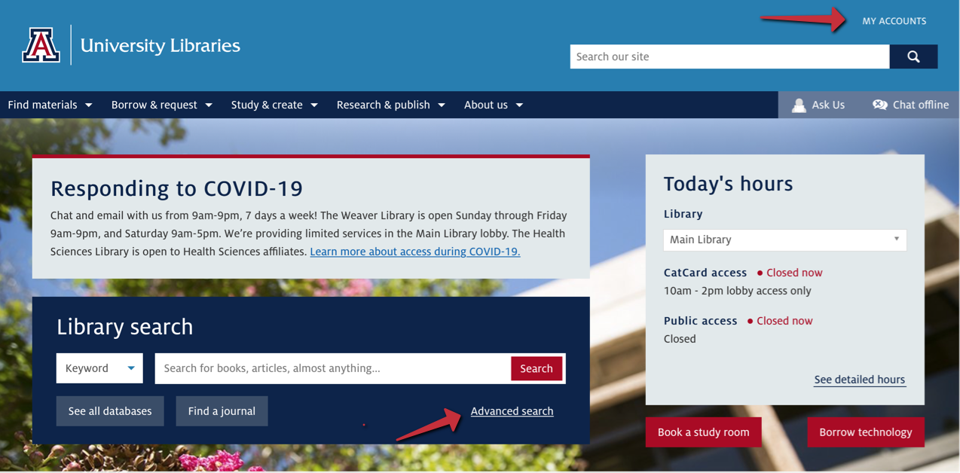
USE LIBRARY SEARCH
https://new.library.arizona.edu

Slide 11
CONNECTING TO E-CONTENT
Access Scholarly Journals from Off-Campus (video) https://vimeo.com/416440574/039817fbf0
Trouble-shoot connecting to library resources (guide) https://new.library.arizona.edu/find/databases/connection-issues
Notes:
https://vimeo.com/416440574/039817fbf0
https://new.library.arizona.edu/find/databases/connection-issues

Slide 12
REQUEST MATERIALS
Document Delivery https://new.library.arizona.edu/request/document-delivery
Interlibrary Loan https://new.library.arizona.edu/request/interlibrary-loan
Notes:
https://new.library.arizona.edu/request/document-delivery
https://new.library.arizona.edu/request/interlibrary-loan

Slide 13
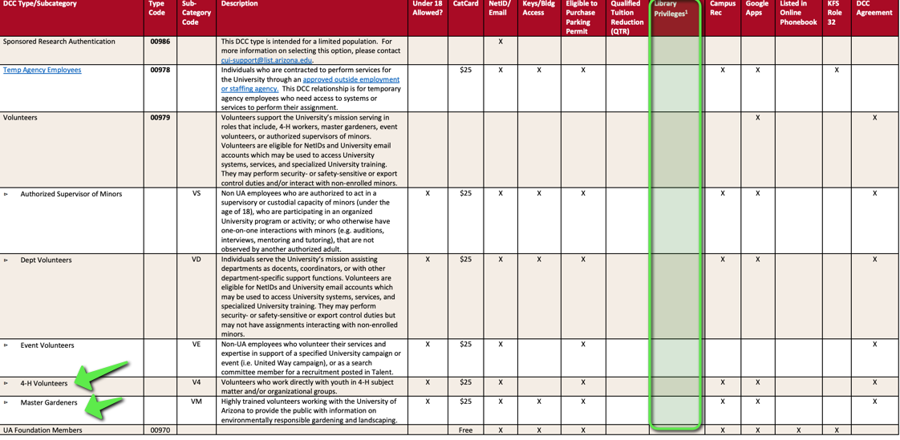
Designated Campus Colleagues & Library Services
https://hr.arizona.edu/sites/default/files/DCC_Srvc_Matrix.pdf
Notes:
1 LIBRARY PRIVILEGES – Library-licensed information resources are expressly licensed to support the University’s educational, research, and outreach mission and many licenses do not allow for commercial use or use by those outside of the University. As such, DCCs who are granted library privileges and who use licensed information must be limited to information needs that arise through their work for and partnerships with the University. Eligible DCCs may check out books, journals, and other library provisioned materials with their CatCard and most online information resources can be accessed either on campus or by logging in with their assigned UA NetID and password. Individuals without appropriate Designated Campus Colleague statuses, including members of the community at large, may access licensed resources for their individual research or educational purposes in libraries on the University’s Main or Health Sciences campuses.

Slide 14
COMMENTS? QUESTIONS?
Contact me:
Jeanne Pfander
jpfander@arizona.edu
Notes:
https://new.library.arizona.edu/people/jeanne-l-pfander Note: You can schedule a meeting through the widget under my photo or by email.

