Slide 1
Bighorn wildfire management
Fire management overview
Chris Stetson
Fire and Fuels Planner
Coronado National Forest

Slide 2
Fire Information/Background
The Bighorn Fire was discovered June 5, 2020. The origin was on Bighorn Mountain in steep, inaccessible terrain on Pusch Ridge located in the Pusch Ridge Wilderness Area of the Catalina Mountains. Initially managed by an IMT3, Southwest Team 2 (Pierson IMT1) was ordered on June 7 based on incident complexity, COVID, predicted duration of the incident, time of year during the normal height of the southwest fire season, and potential impacts to adjacent communities in Oro Valley and Catalina foothills. The incident was managed under a full suppression strategy utilizing a combination of direct attack, indirect attack, and point protection.
SW Team 2 transitioned with Northern Rockies (NR) Team 1 with transfer of command on June 22. NR Team 1 continued with a similar course of action, managing the fire utilizing direct attack when topography and fire behavior allowed, indirect attack utilizing roads and dozer lines followed by burnouts, and point protection under a full suppression strategy. The Northern Rockies Type 1 IMT managed the Bighorn Fire for 14 days before transferring command to the SWA Type 2 IMT 4 at 0600 on July 5, 2020.
On Monday, July 13, 2020 at 0600, the Southwest Area Incident Management Team 4 transitioned management of the 119,250-acre Bighorn Fire back to the Coronado National Forest, commanded by Type 4 Incident Commander. The fire was called contained on July 23rd at a final acreage of 119,978 acres. (Figure 1.)

Slide 3
Fire Information/Background continued
Landownership impacted by fire.
Landowner | Acres
Coronado NF | 108,100
Private | 6,074
State | 5,685
Other | 119
Total | 119,978

Slide 4
Fire Information/Background continued

Slide 5
Fire management factors
Firefighter and public safety #1
COVID
Steep/inaccessible terrain
Weather – peak fire season, heat related illness
Fuels
abundant fine fuels from previous winter precipitation
Low fuel moistures
Dead and down fuels from previous fires
Values at risk – top and bottom of mountain

Slide 6
Strategies and tactics
Protect WUI
Point protection
Strategic burn out operations
Mitigate high severity fire impacts to natural resources
Strategic burn out operations

Slide 7
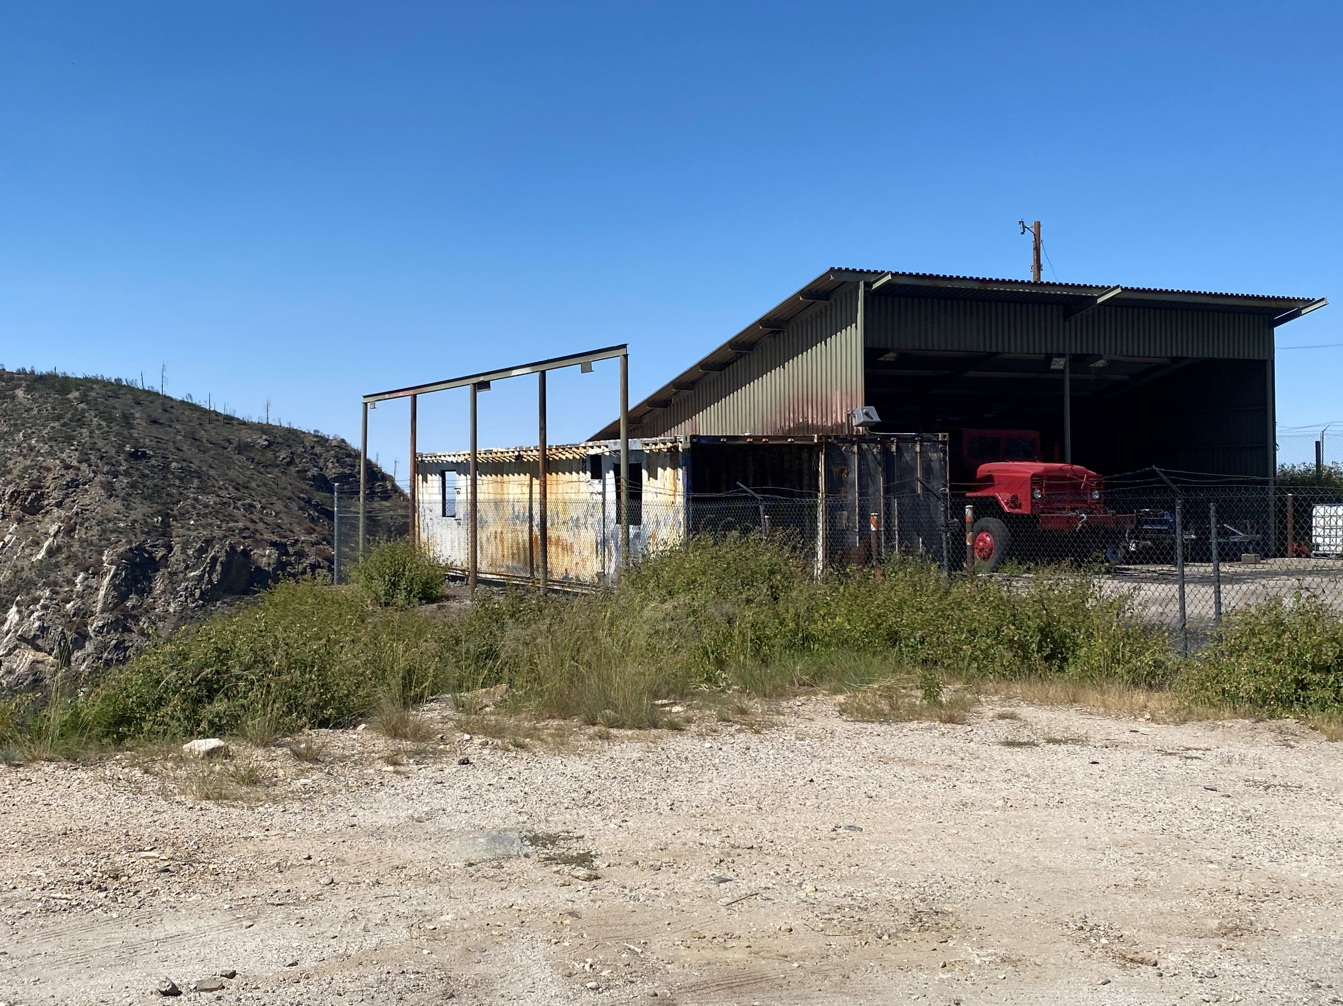
Outcomes
2 outbuildings damaged
Capitalized on previous treatments

Slide 8
Outcomes
Utilize “top down” firing techniques to reduce intensities and prevent uphill runs.

Slide 9
Questions ?? christopher.stetson@usda.gov

