Slide 1
NRULPC Advisory Board Meeting
November 16, 2021 | 8:30 am-12:00 pm

Slide 2
Welcome and Check-in - Joe Willis and Andy Groseta, Co-chairs, Advisory Board

Slide 3
Review Agenda - George Ruyle and John Lacy, Co-directors
Agenda
Highlights of NRULPC Progress
Panel Discussion
Clinic Program Review
Student Introductions
Student Projects Overview
Undergraduate Class Update
AB Members Introductions
Campaign Update
Communications Update
Regulatory Roundup
Thank You’s and Adjourn
Next Meeting – Spring 2022

Slide 4
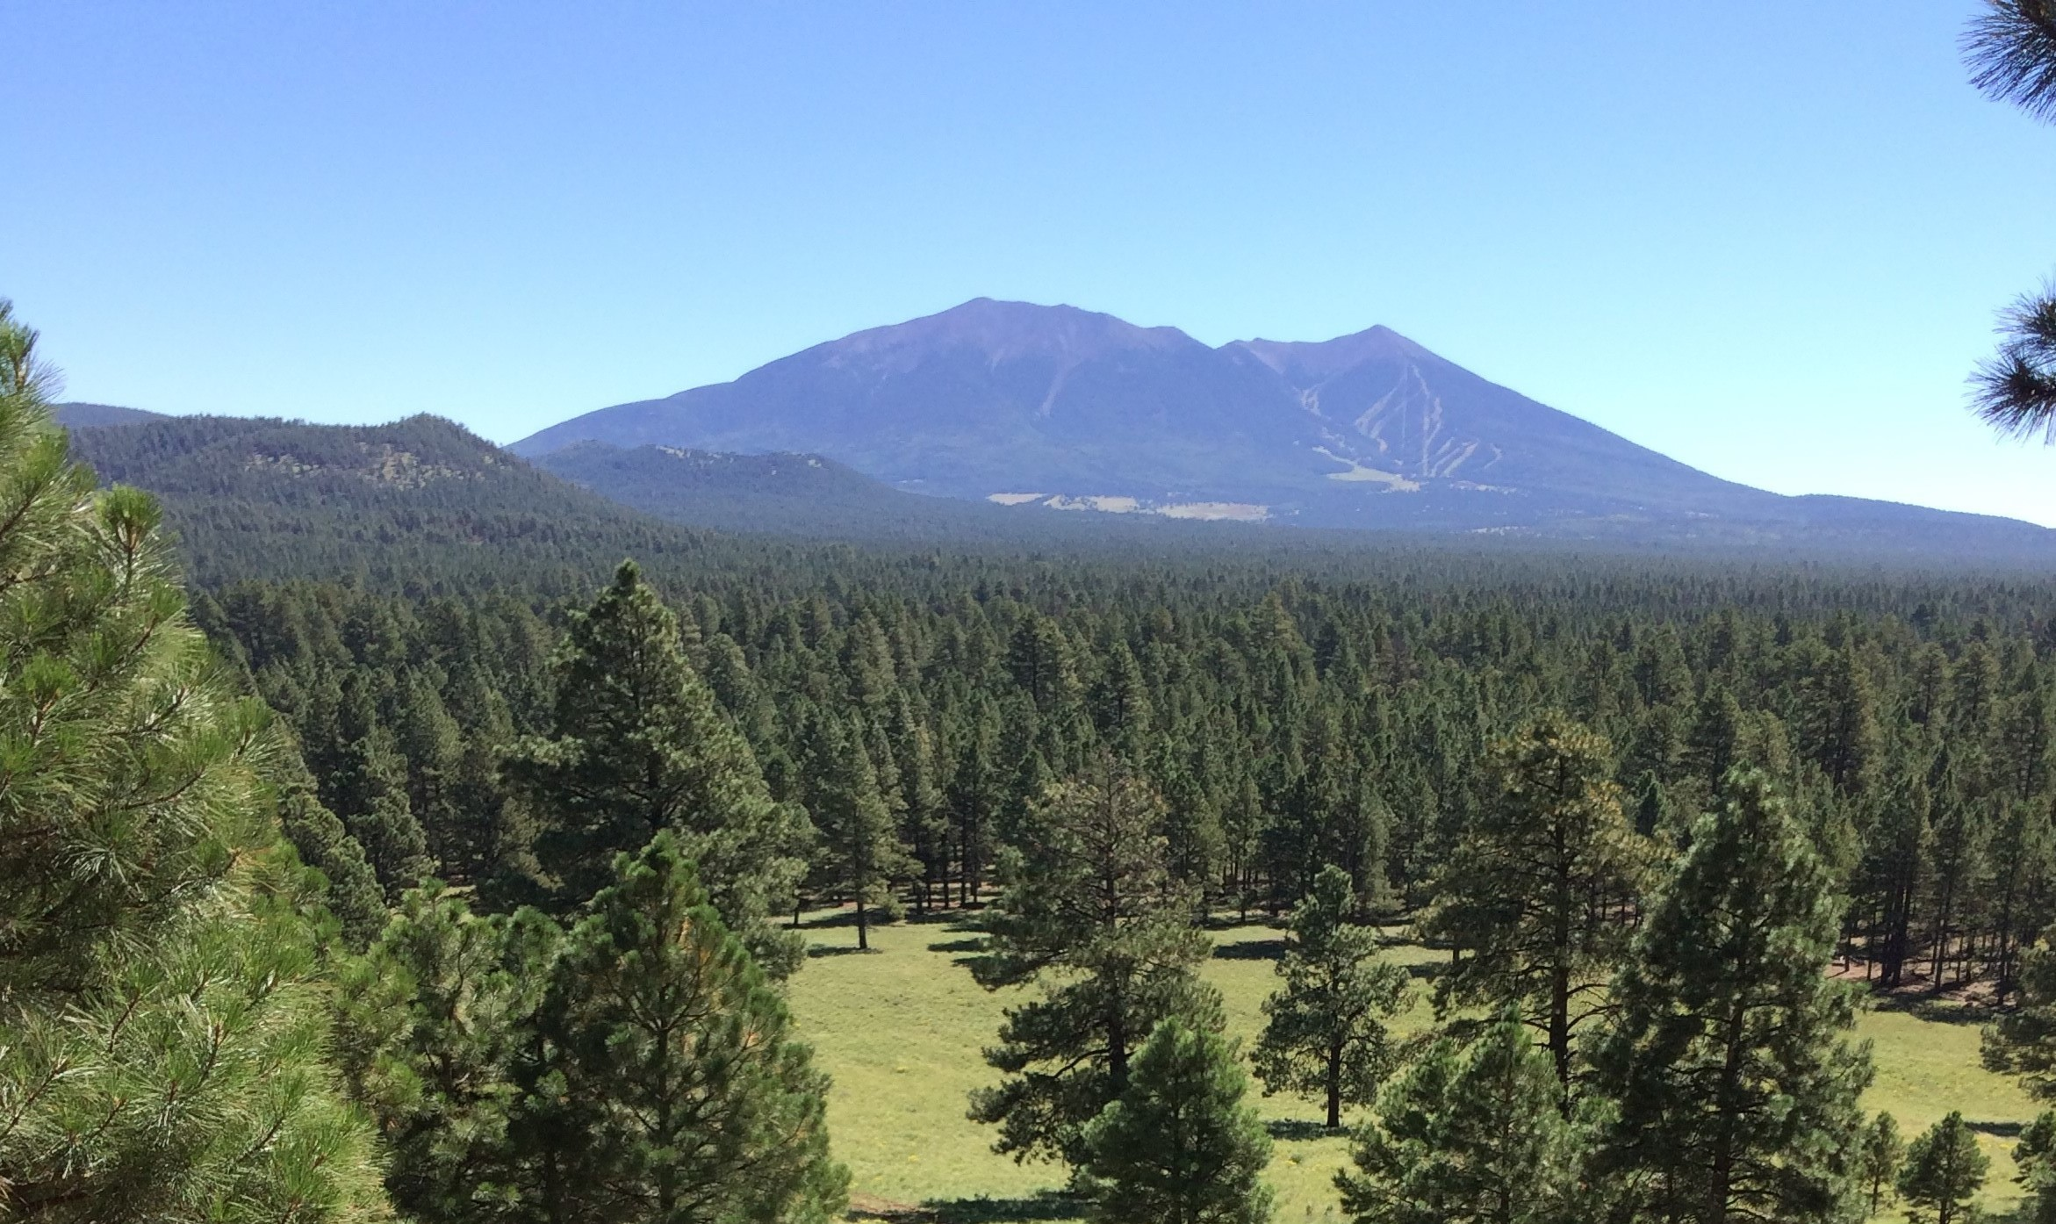
NRULPC Progress Highlights - George Ruyle and John Lacy, Co-Directors
The Center's overall mission is to help landowners, farmers, ranchers & small miners in Arizona navigate the legal and regulatory hurdles in using the land.

Slide 5
Benefiting the Natural Resource Community by:
Exposing students to complex natural resource law and policy matters through the NRUM Clinic – Examples of “learning by doing”
Increasing the law and policy analysis capacity of Cooperative Extension to serve natural resource users
Building partnerships amongst natural resource users and the larger community
Offering a public interest Natural Resources Use and Management Clinic to serve stakeholders and engage students
Helping stakeholders in Arizona and the West solve their legal hurdles

Slide 6
Recent Center Projects - Jeff Eisenberg, Consultant
Consultation regarding drought-influenced stocking rates
Submitted comments on U.S. Army Corps of Engineers (USACE) and the Environmental Protection Agency (EPA) pre-proposal Request for Recommendations concerning a new rule governing WOTUS
Assisted the San Carlos Irrigation and Drainage District (SCIDD) work through the federal process for repairing its dam and funding improvement of its canals
Assisted FS grazing permittees with questions on Annual Operating Instructions (AOI) procedures
Assisted AZ stakeholders obtain federal funding in response to destruction from Telegraph Fire
Potential rancher liability for personal injury on state lease land

Slide 7
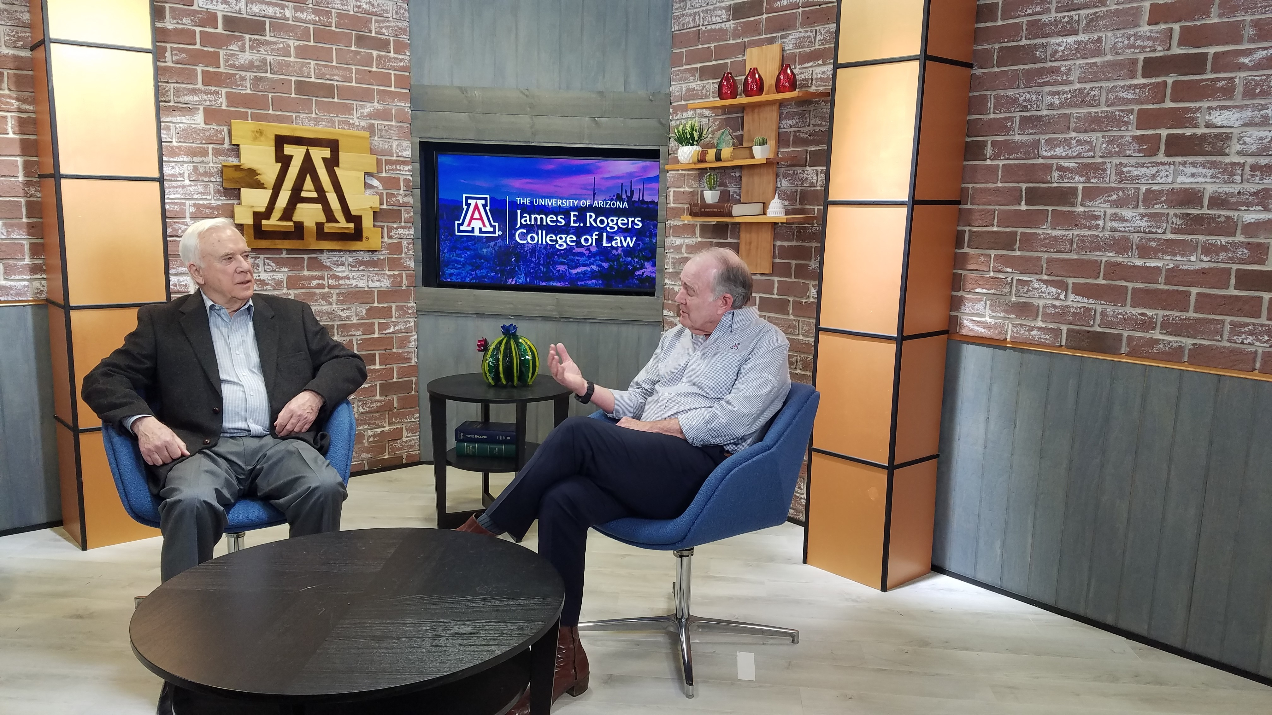
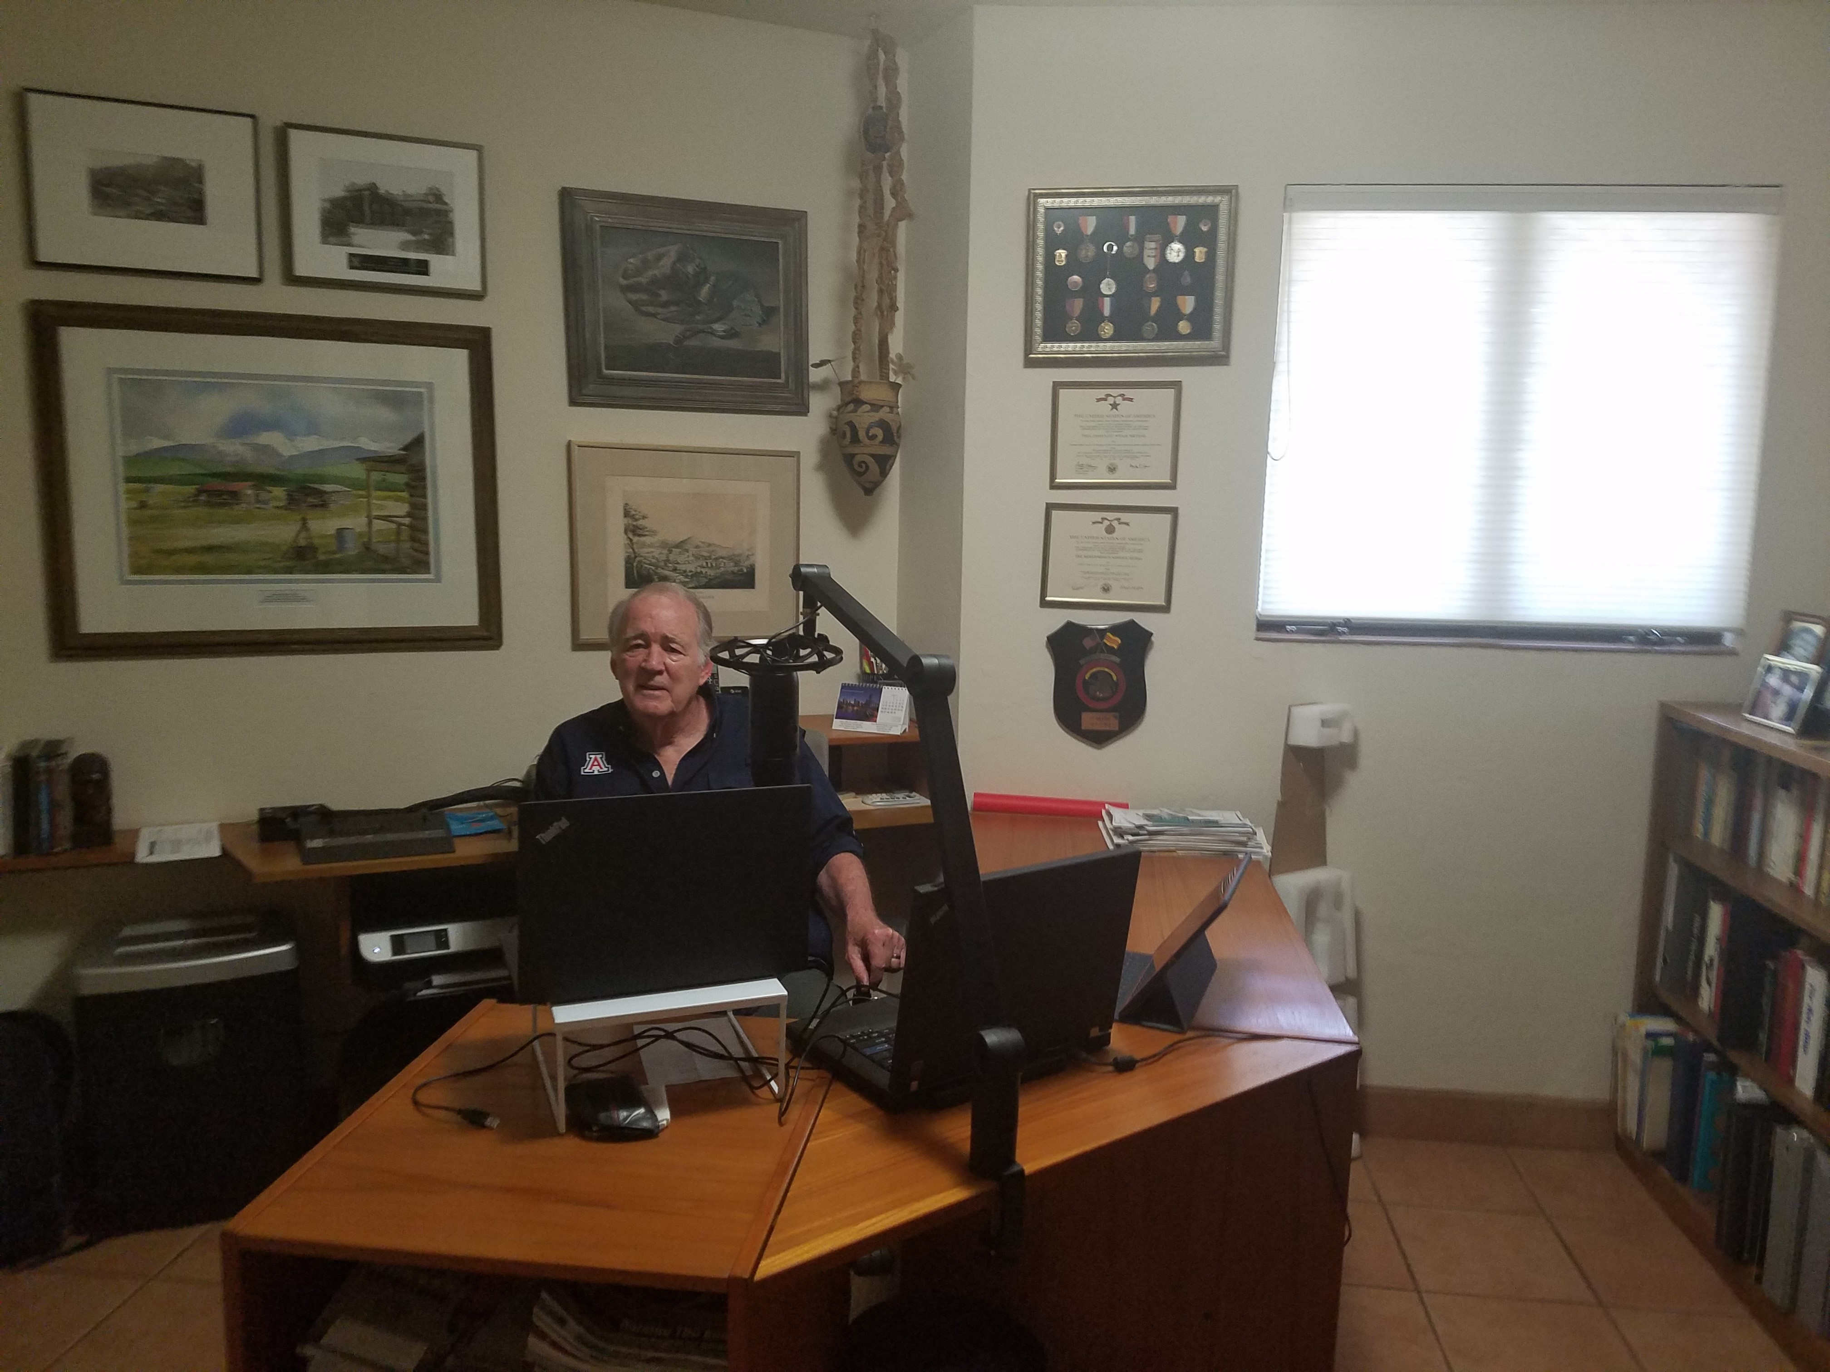
Online Training Programs
Course on Developing Public Lands Under the National Environmental Policy Act
Course on Public Land Use
Available to students in the Clinic, students in CALS and as executive training
Video postings of lectures and interviews on current topics
Colorado River conservation
Waters of the United States
Undergraduate Courses on Natural Resources Issues
In the planning process
Part of the collection of interdisciplinary courses prepared for the new School of Mining and Mineral Resources

Slide 8
Panel Discussion
Perspective on thinning and the use of wood products in Arizona; issues with scaling up
Don Falk - Forest ecology and resilience: how will our forests recover?
Tom Shultz - Forest Health in the Intermountain West
Doyel Shamley - Forest timber sale volumes, acres treated, increasing fuel loads and the impacts to our National Forests in AZ
James Voyles - NEPA, Regulatory Reform, and Active Forest Management

Slide 9
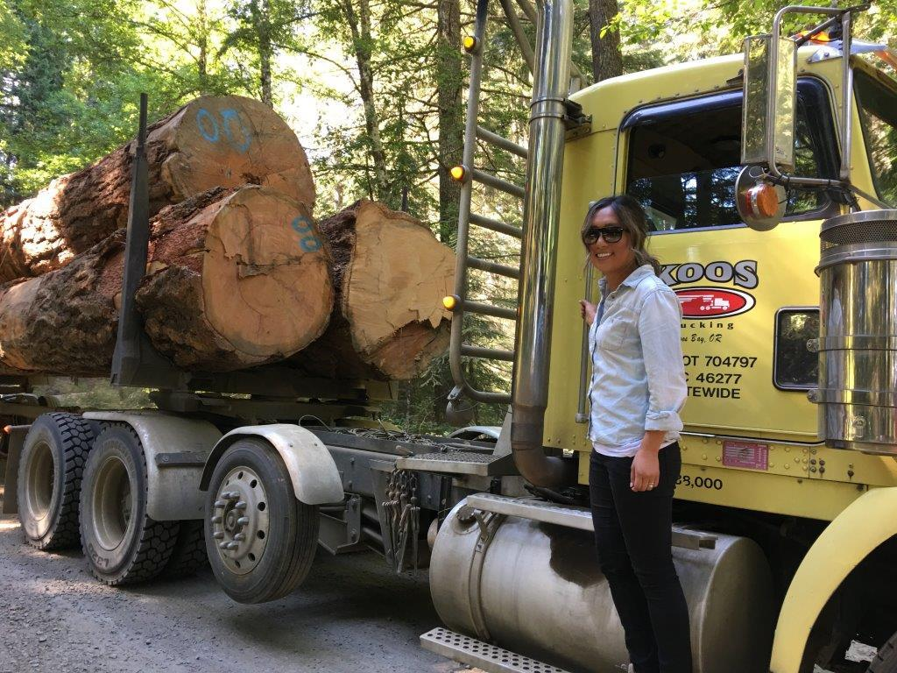
Clinic Program Review - Priya Sundareshan, Clinic Director
6 JD students and 1 MS student currently enrolled in Fall 2021
7 JD students in Fall 2019; 3 JD and 1 MLS in Spring 2020; 5 JD and 1 MLS in Fall 2020; 4 JD students in Spring 2021
JD students did a hybrid externship/clinic enrollment with Idaho Forest Group over Summer 2019 and Summer 2020
*Student internships a great way to get students into field; if you have ideas for possible internships, can work with Clinic and Center to circulate to students and facilitate.

Slide 10
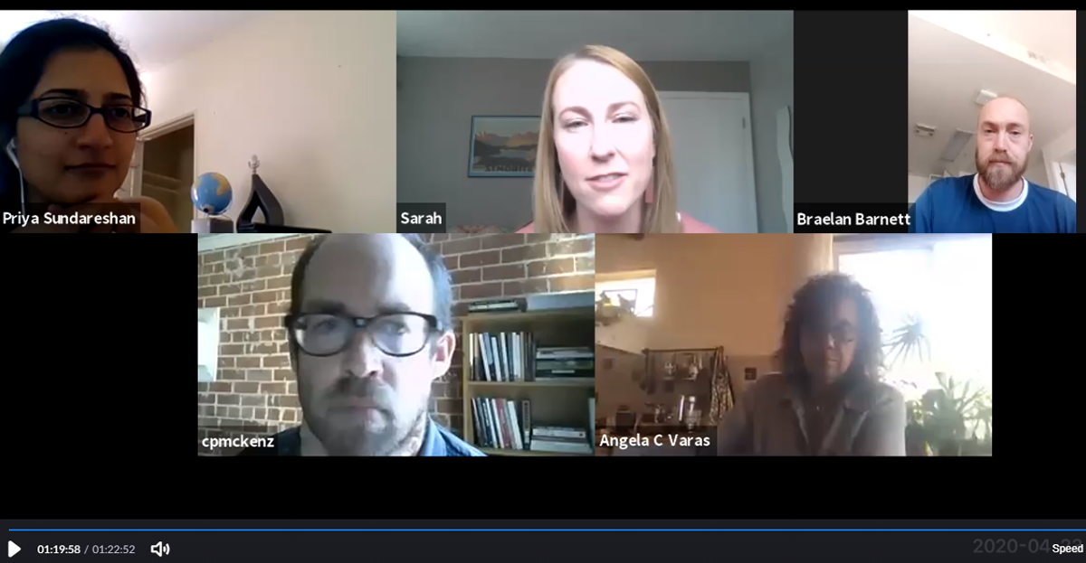
Clinic Structure
Weekly seminars: students meet in classroom, lessons on substantive law, project rounds, student presentations, guest lecturers, exercises.
Individual projects: students work alone or in groups on projects for the NRULPC, Cooperative Extension, tribes, and other client organizations.
Weekly individual meetings with Director or Fellow, in addition to meetings with NRULPC, clients, and University experts.
Class and project meetings are being held in person and with a Zoom option

Slide 11
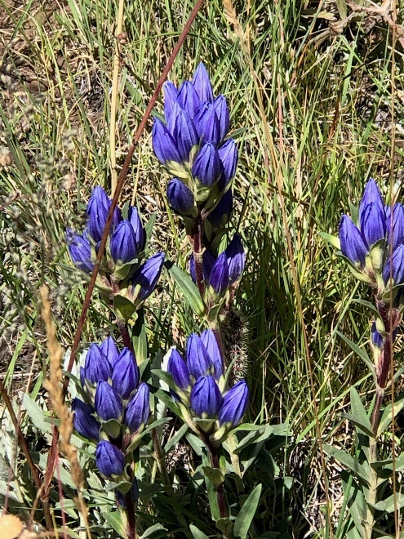
Current Clinic Projects
Notice and comment process and engagement
Council on Environmental Quality Phase 1 proposed NEPA regulations
Planning curriculum and conducting outreach about the state water rights adjudication to Verde Valley residents and realtors
Explaining Arizona water law and federal reserved rights for non-legal audiences, and exploring incorporation of Navajo Nation traditional uses in the adjudication
Identifying strategies to address Colorado River allocation scarcity
Analysis of recent Arizona case law and impacts on renewable energy development in Arizona

Slide 12
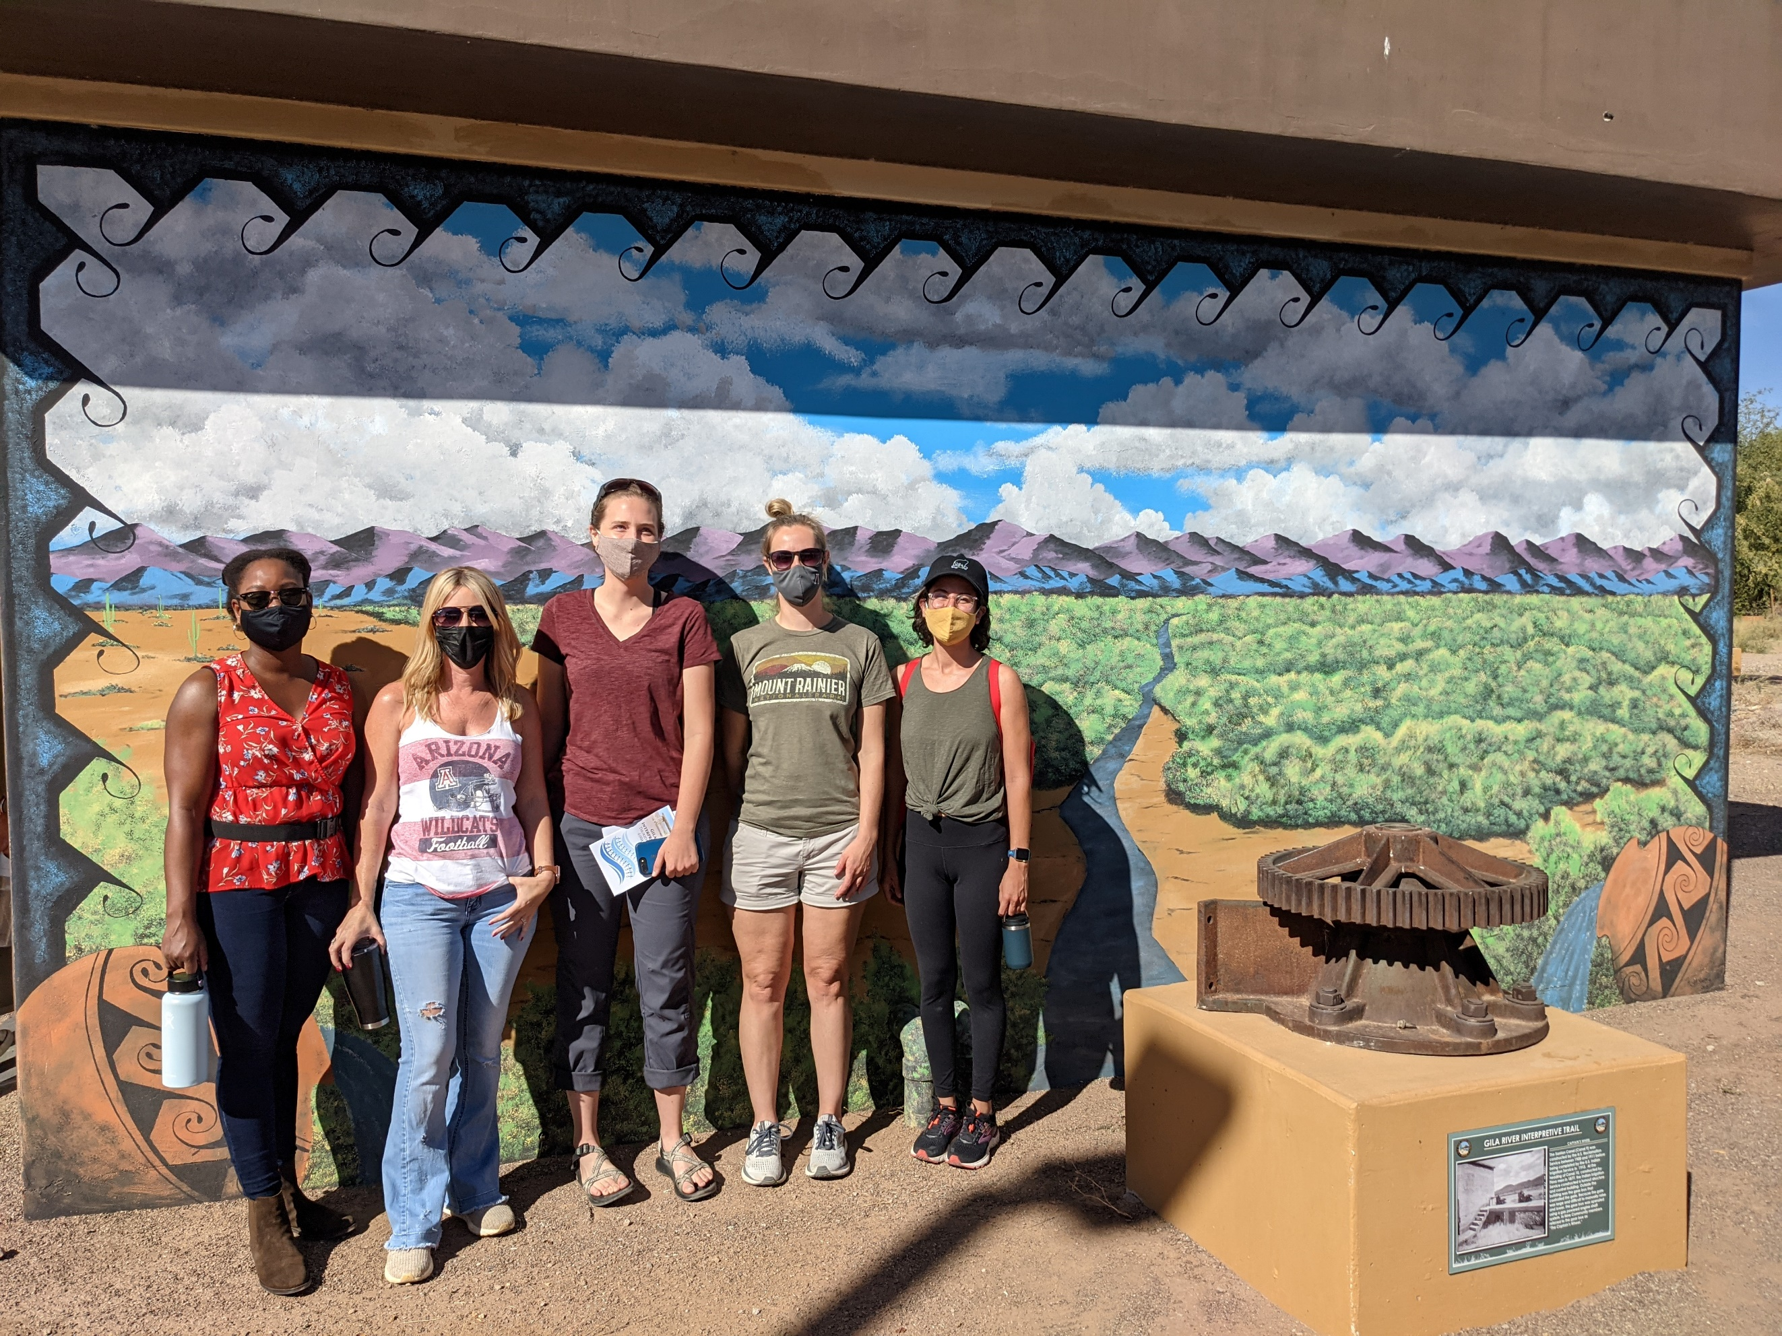
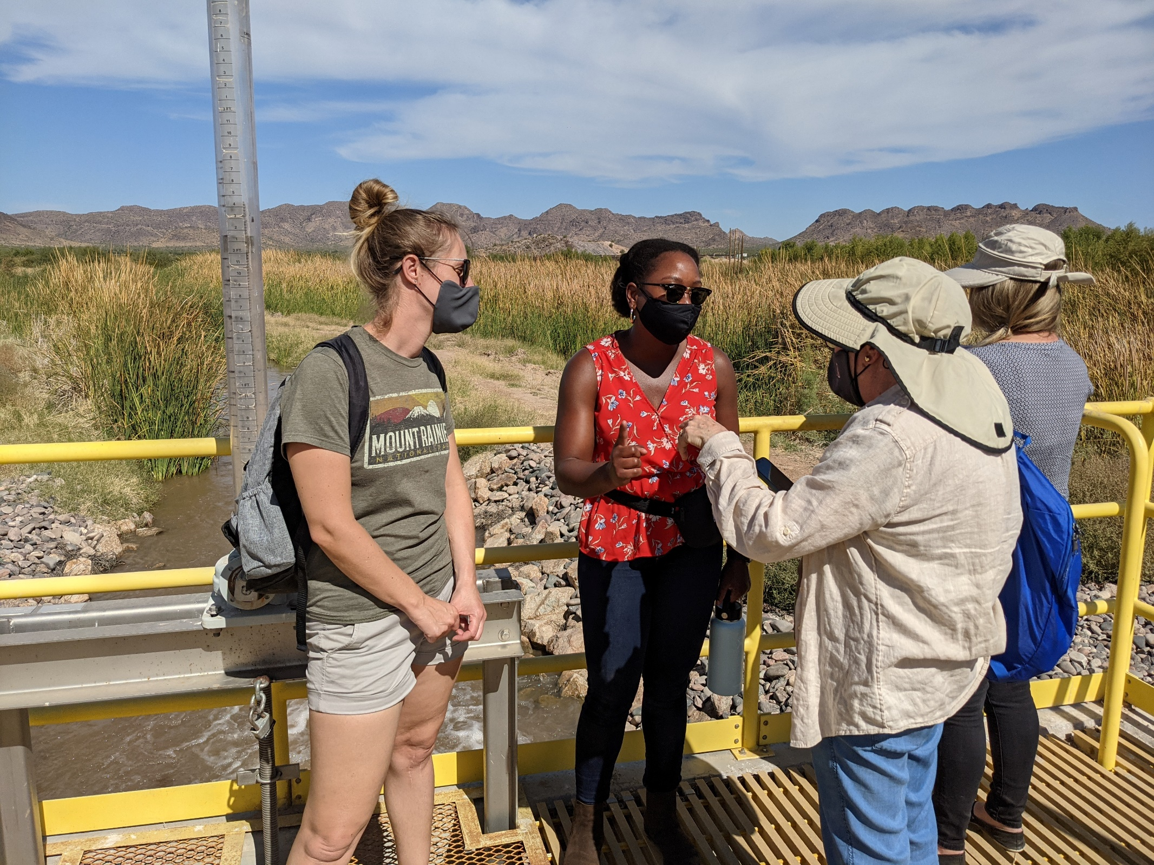
Outside the Classroom – Gila River Indian Community’s Managed Aquifer Recharge site with WRRC

Slide 13
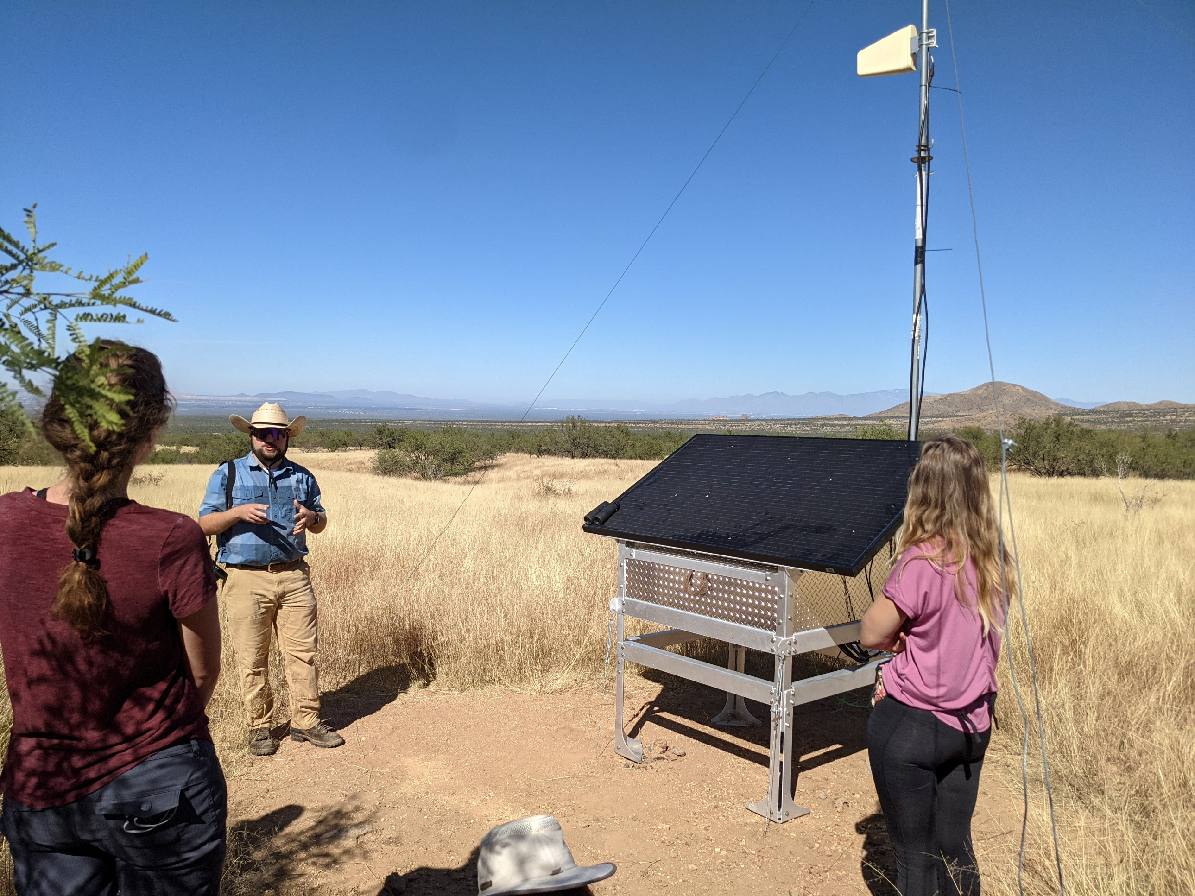
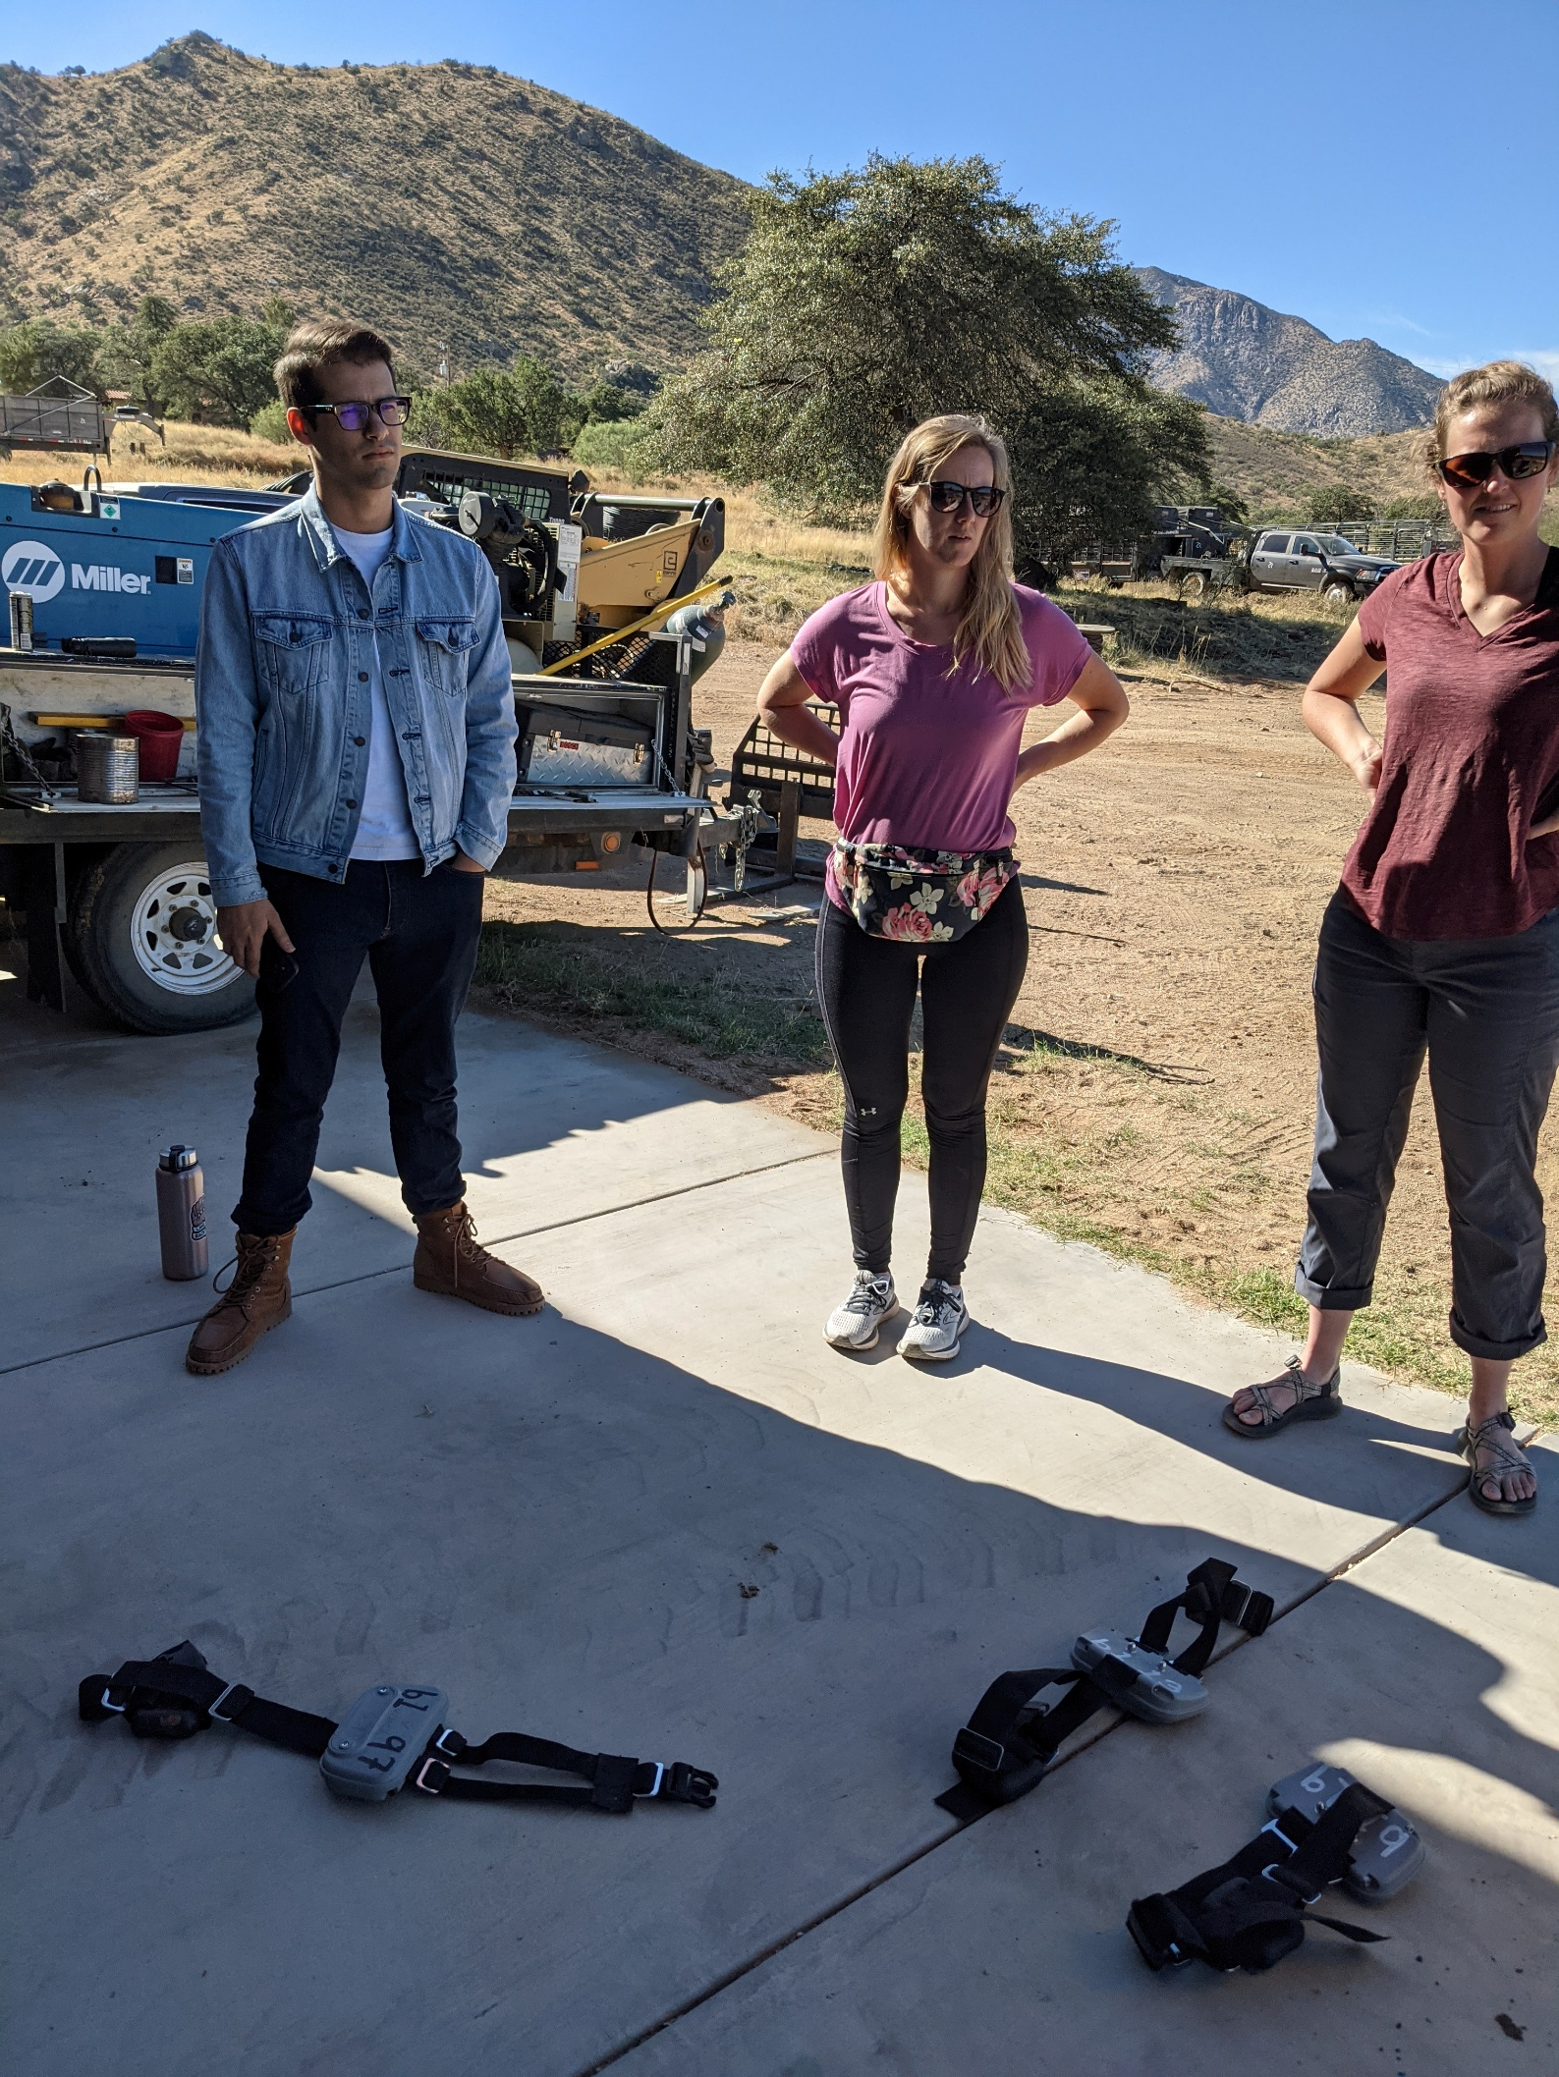
Outside the Classroom – Santa Rita Experimental Range & Ranch

Slide 14
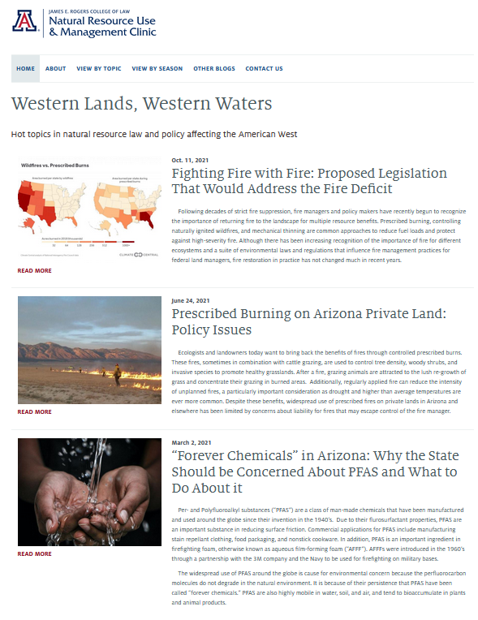
Western Lands Blog
https://westernlandsblog.arizona.edu/

Slide 15
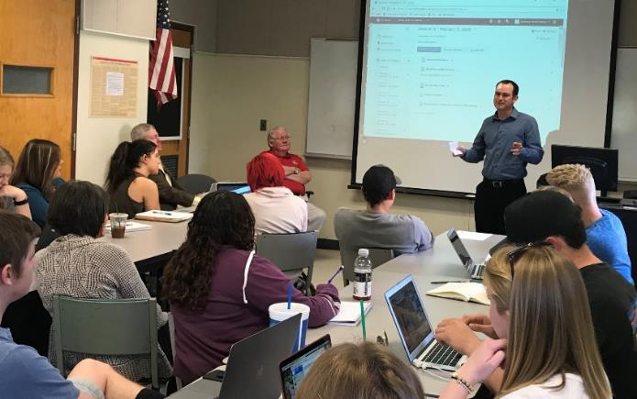
Agriculture, Environmental and Legal Issues Course Update ACBS/RNR/LAW 411 Joint Course Spring 2022 - Course instructors: Joe Willis, Esq. and Anne Gondor
Overall purpose is to present a balanced view from the resource users' perspective and promote law as a career option to students working on degrees associated with natural resource use
2022 – Scheduled to be in person with Live Zoom if needed
17 Industry expert guest speakers typically scheduled for
topics such as NEPA, ESA, WOTUS, CERCLA, etc.
Materials, quizzes, exams delivered by D2L
How do we encourage more SNRE students?
Now cross-listed with RNR
Photo: Spring 2019
Notes:
The ACBS-LAW 411 Joint Course is titled An Introduction to Agricultural Law and Policy for the Modern-Day Natural Resource User. The overall purpose of the class is to present a balanced view from the resource users’ perspective as well as to promote law as a career option to students working on degrees associated with natural resource use. My observation is that we also need to create a start and end survey to gauge whether or not we are reaching that goal to understand the student's motivation for taking the class and if their trajectory changes towards law after the class. In 2020 we had 18 students from ACBS and 7 students from LAW, How do we NOW encourage more students joining the course from SNRE programs? the School of Natural Resources and the Environment?
This spring semester the course will be entirely online, with synchronous Live Zoom lectures and plans for having 16 guest speakers. Content materials, quizzes, exams and assignments will all be delivered using D2L

Slide 16
Break
Back at 10:50

Slide 17
Advisory Board Member Introductions & Interests - John Lacy
Introduce yourself
Describe in one or two sentences a current natural resource issue you are working on or are concerned about

Slide 18
Financial Update (updated after meeting) - George Ruyle, John Lacy and Priya Sundareshan
Contributors
Businesses:
Rosemont Copper
Idaho Forest Group
Plummer Forest Products
South Coast Lumber
Individuals:
Menges Ranches
Sarah Lawson
Paco Ollerton, Tierra Verde Farms
Joe Willis
Kirk Johansen
Total: $14,500
Financial Status – FY22
Stream adjudication funding
SB1825 authorized clinic representation of claimants
SB1823 provided funding
CARES
Update on campaign

Slide 19
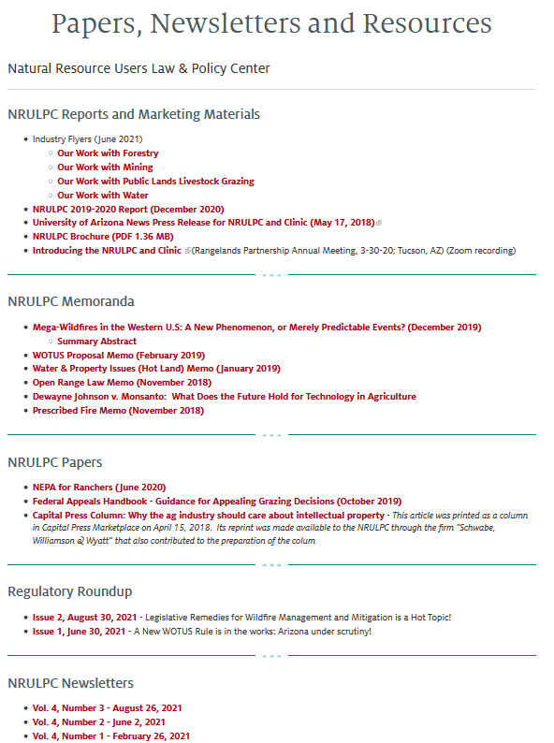
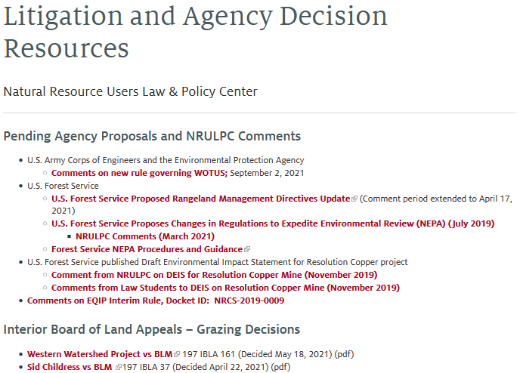
Communications update - Sheila Merrigan and Anne Gondor
Current communication outlets
Newsletter
Listserv
Website - https://extension.arizona.edu/nrulpc
Litigation, agency decisions, and other resources
Blog
Regulatory Roundup

Slide 20
Adjourn
THANK YOU
FOR YOUR COMMITMENT TO THE NRULPC and CLINIC!
Next Meeting – Spring 2022

