Slide 1
NRULPC Advisory Board Meeting
November 27, 2018; 10:00am – 11:30am

Slide 2
Welcome, Introductions, Review Agenda - Joe Willis, Advisory Board Chair & Andy Groseta, Advisory Board Vice-Chair
Purpose:
“To Clarify Role of Advisory Board, Gain Commitment, & Update on Center and Clinic Activities”
Goals of Meeting:
Name change
Agree on roles & responsibilities
Update on progress & successes
Strategy for the future

Slide 3
Review Draft Advisory Board Roles & Responsibilities - Joe Willis, Advisory Board Chair & Andy Groseta, Advisory Board Vice-Chair
Refer to handout on Roles and Responsibilities
Role of Advisory Board
Meetings of the Advisory Board
Outreach Activities of the Advisory Board Members
Action: Please be thinking about these roles & responsibilities during the following presentations

Slide 4
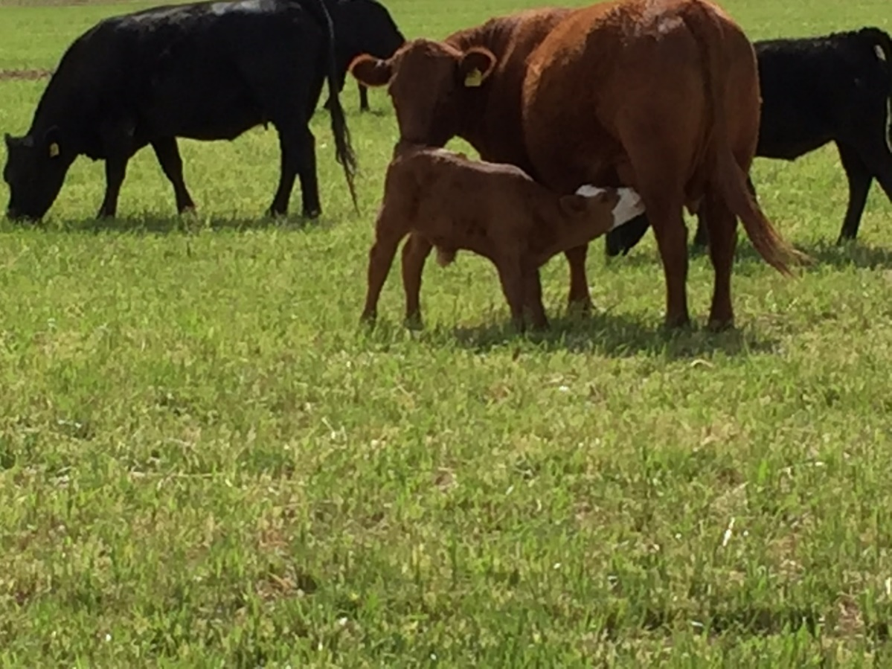
Overview of NRULPC Progress - George Ruyle & John Lacy, Co-Directors
The Center is about helping landowners, farmers and ranchers in Arizona solve their legal and regulatory hurdles to using the land.

Slide 5
Current Projects for Center
Rx burning liability issues (developing a legal framework for the use of prescribed fires by private landowners)
Yuma Island land and water status
Labor shortage crisis in dairy industry (TN Visas for Dairy Technicians, case law review)

Slide 6
Current Projects for Center
Agency for Toxic Substances and Disease Registry (ATSDR) jurisdiction over confined animal agriculture
Researched memorandum on the status of open range laws
Advising landowners in the Gila River Valley about their legal options to optimize the use of their water

Slide 7
Current Projects for Center
NEPA tutorial to help Extension agents best serve user interactions with federal agencies in getting projects authorized
Mediation for grazing allotment disputes, starting with drought related disputes
Assessment and allocation of vacant grazing allotments

Slide 8
Current Projects for Center - Online Training
Developing Public Lands Under the National Environmental Policy Act
Public Land Use
Available to students in the Clinic, students in CALS and as executive training

Slide 9
NEPA Course

Slide 10
NEPA Course

Slide 11
Overview of NRULPC Progress

Slide 12
Overview of NRULPC Progress

Slide 13
Overview of NRULPC Progress

Slide 14
Overview of NRULPC Progress

Slide 15
Clinic Activities - Bethany Sullivan, Clinic Director
The clinic began operating in January 2018, with 5 student participants (all JDs).
Over the summer, one student stayed on as a clinic fellow.
This semester there are 7 student participants, including one Public Policy Masters.
Spring 2019 also looking like 7 students (all JDs, 4 continuing).

Slide 16
Clinic Structure
Weekly seminars: students meet in classroom, lessons on substantive law, project rounds, student presentations, guest lecturers, exercises
Individual projects: students work alone or in groups on projects for the NRULPC, Cooperative Extension, tribes, and other client organizations.
Weekly individual meetings with Director, in addition to meetings with clients and University experts.

Slide 17
Example Clinic Projects
Mexican Gray Wolf Recovery Plan
Analyzed regulatory issuances and related litigation
Consulted with AZ Game & Fish/UA wildlife biologist
Drafted layperson’s article for NRULPC Newsletter to explain recovery plan, major issues, litigation and future challenges
Cobre Valley Water Rights Adjudication Memo and Presentation
Worked with WRRC on Cobre Valley water assessment project
Community concerned with general stream adjudication and how water uses will be impacted
Memo on water rights adjudication, groundwater regulation, and WOTUS
September small town forum, presentation on the general stream adjudication
Administrative Appeals Handbook
Supporting NRULPC initiatives

Slide 18
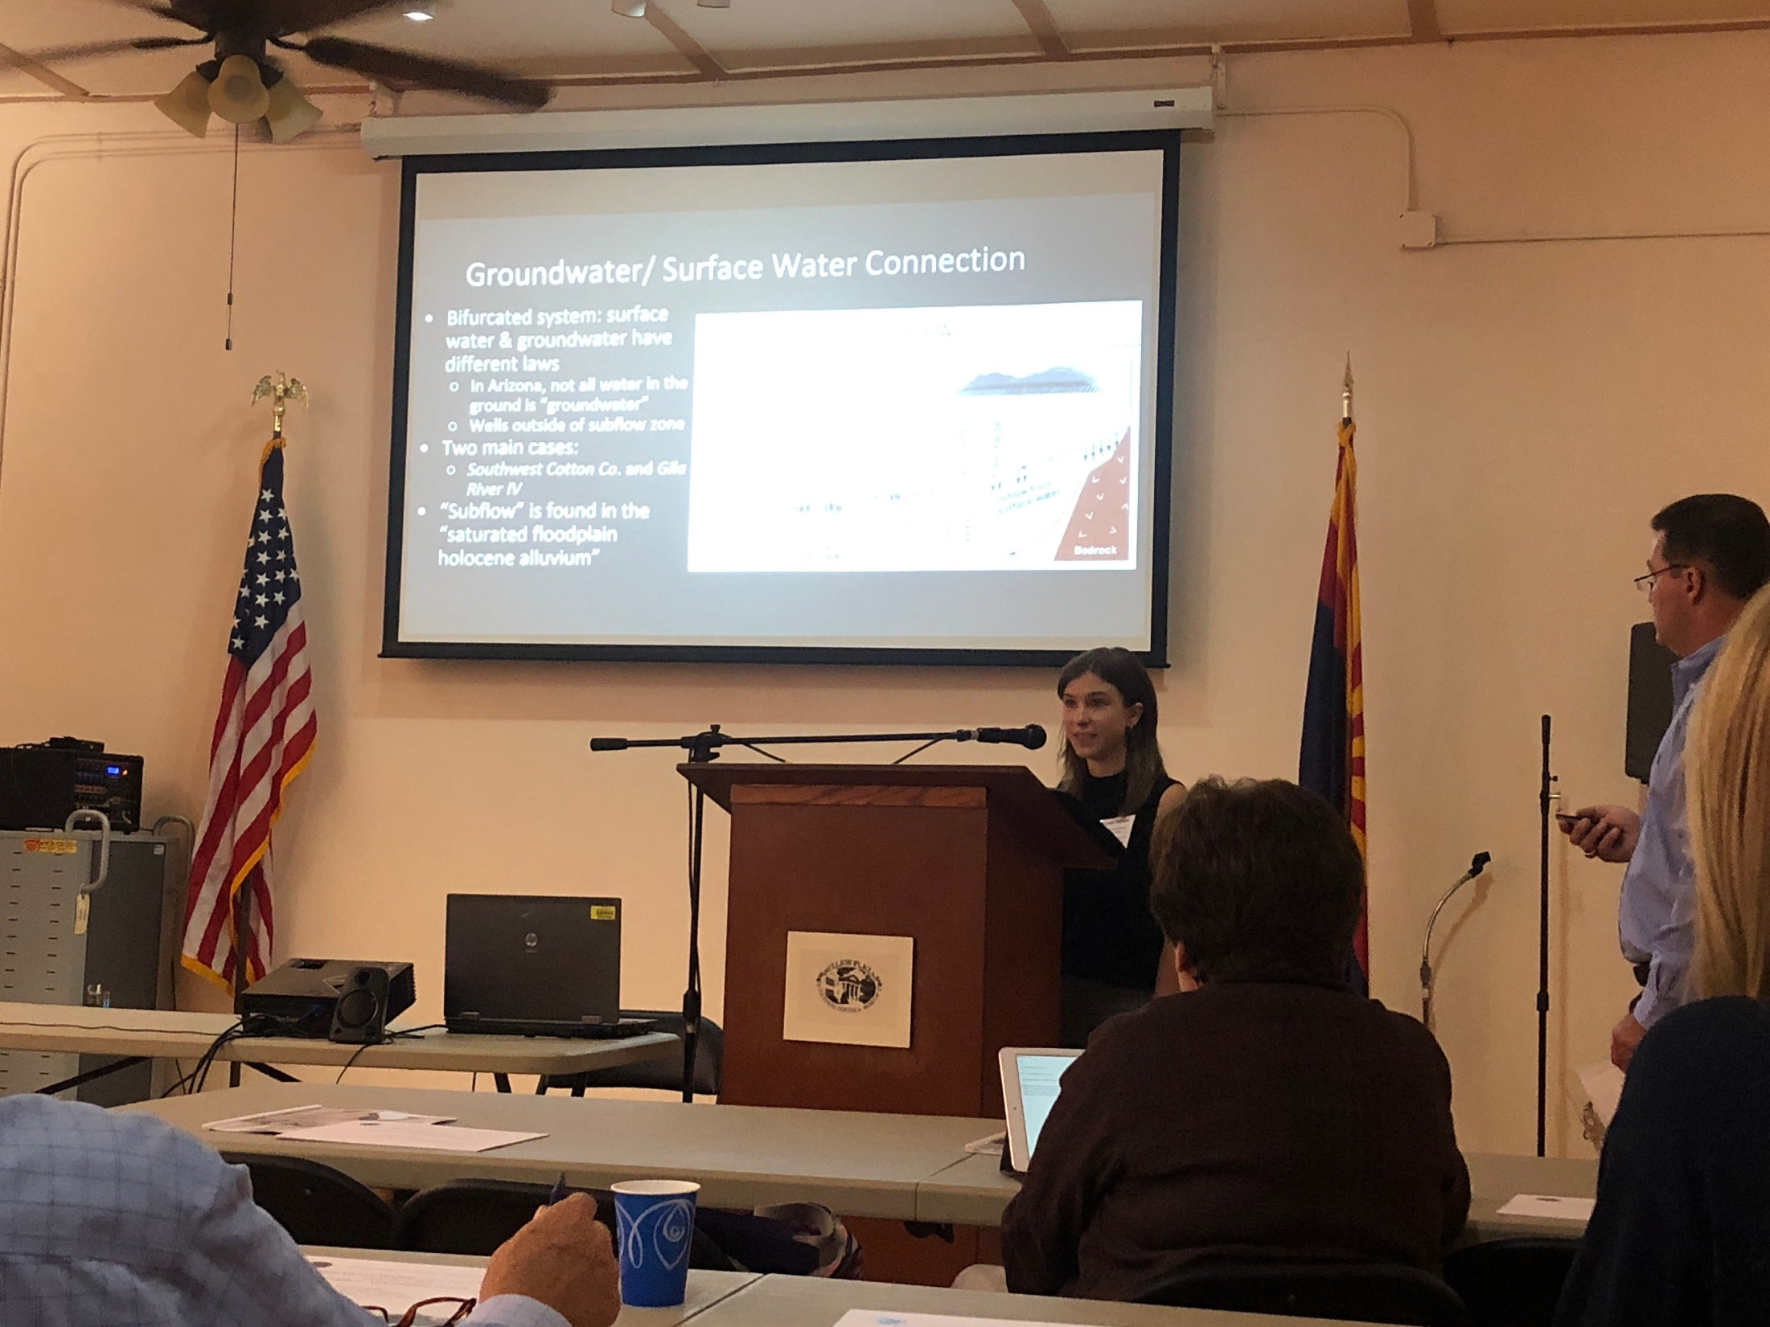
Outside the Classroom – Gila River Water Rights Presentation in Globe, AZ

Slide 19
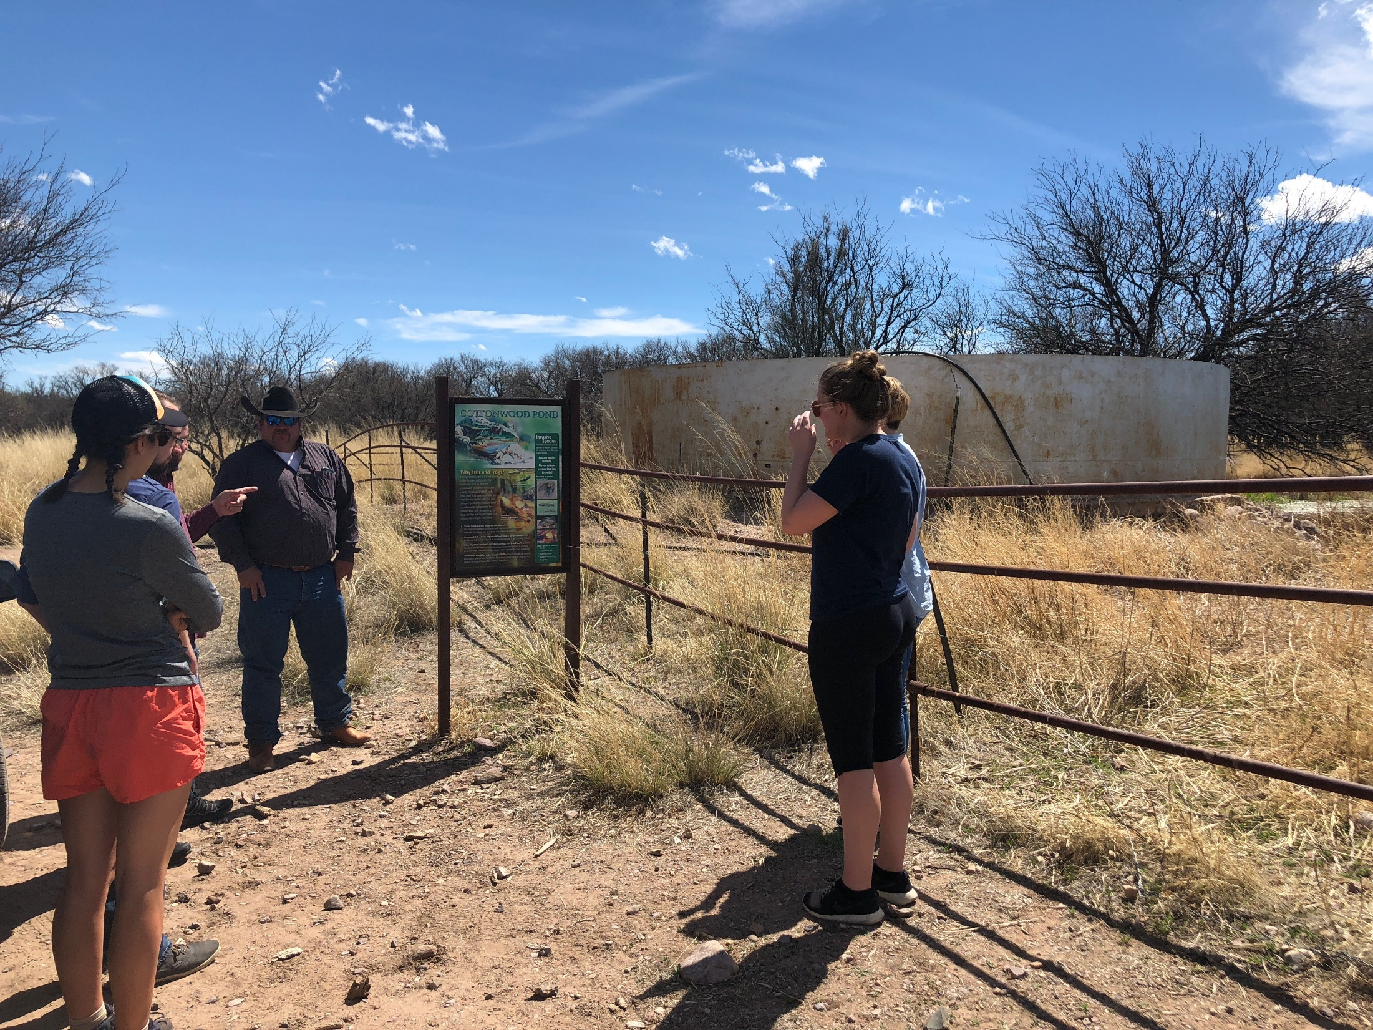
Outside the Classroom – Field Trip to Vera Earl Ranch and Empire Ranch

Slide 20
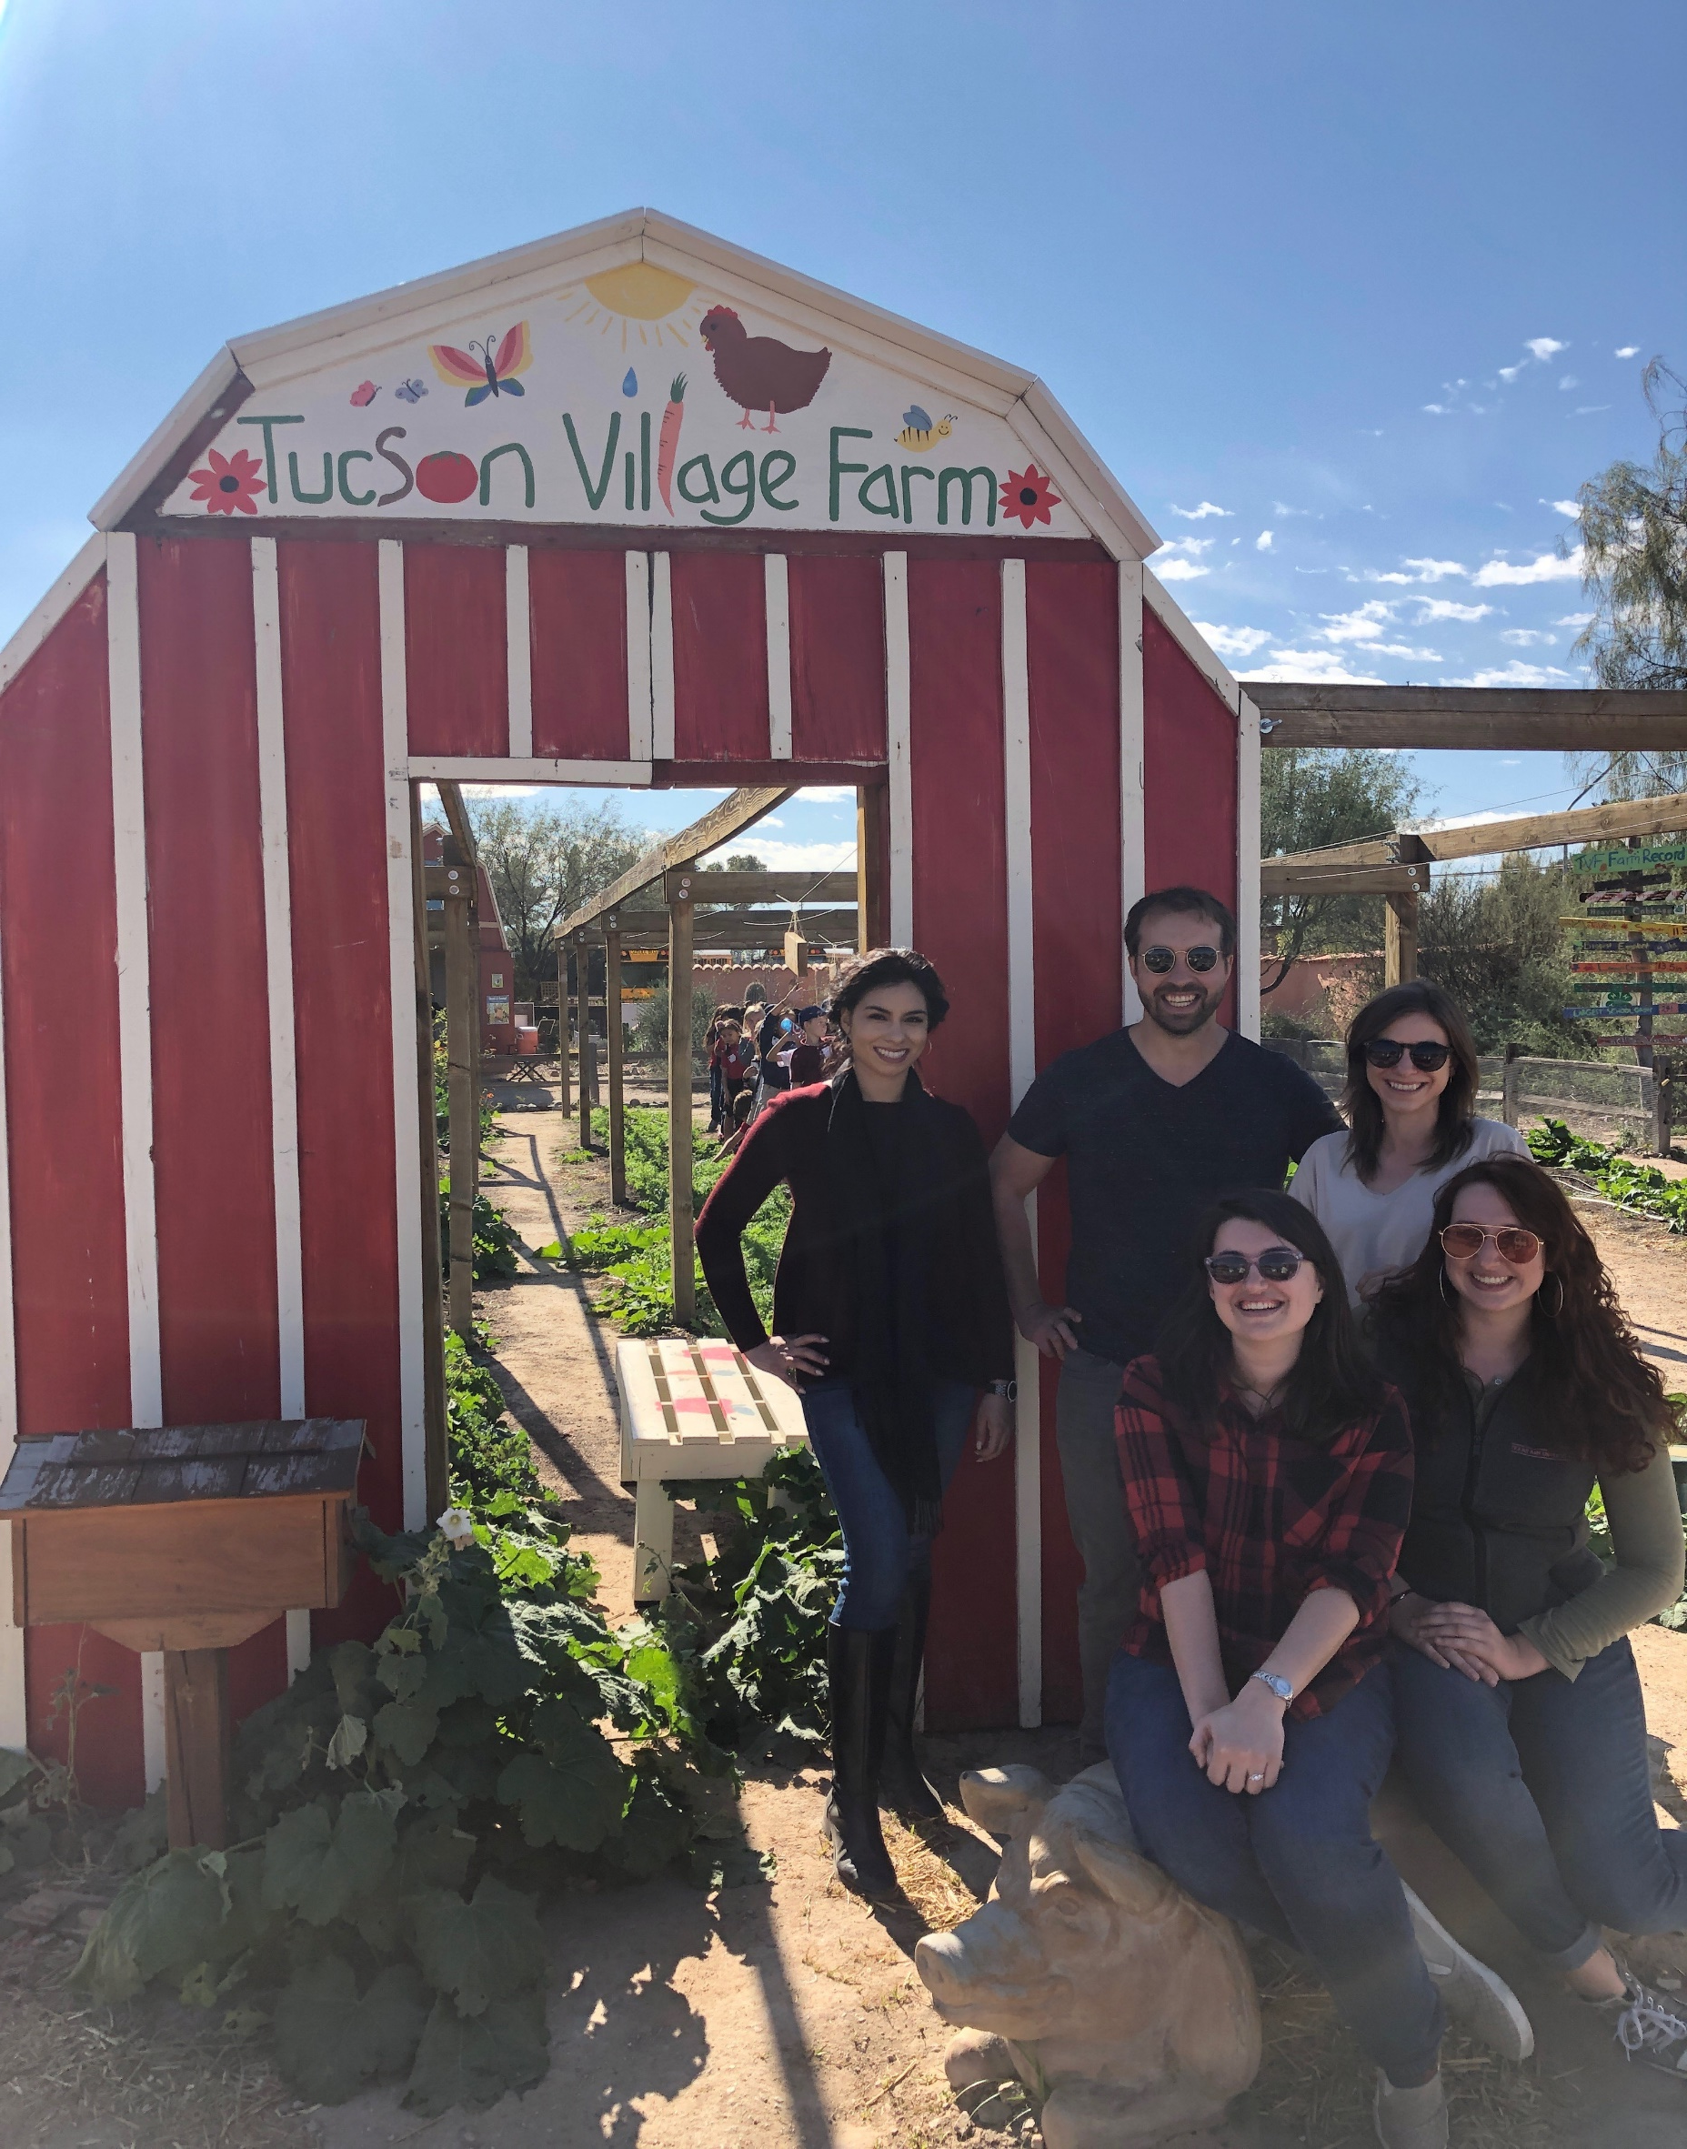
Outside the Classroom – Field Trip to Campus Agricultural Center & Pima County Cooperative Extension Office

Slide 21
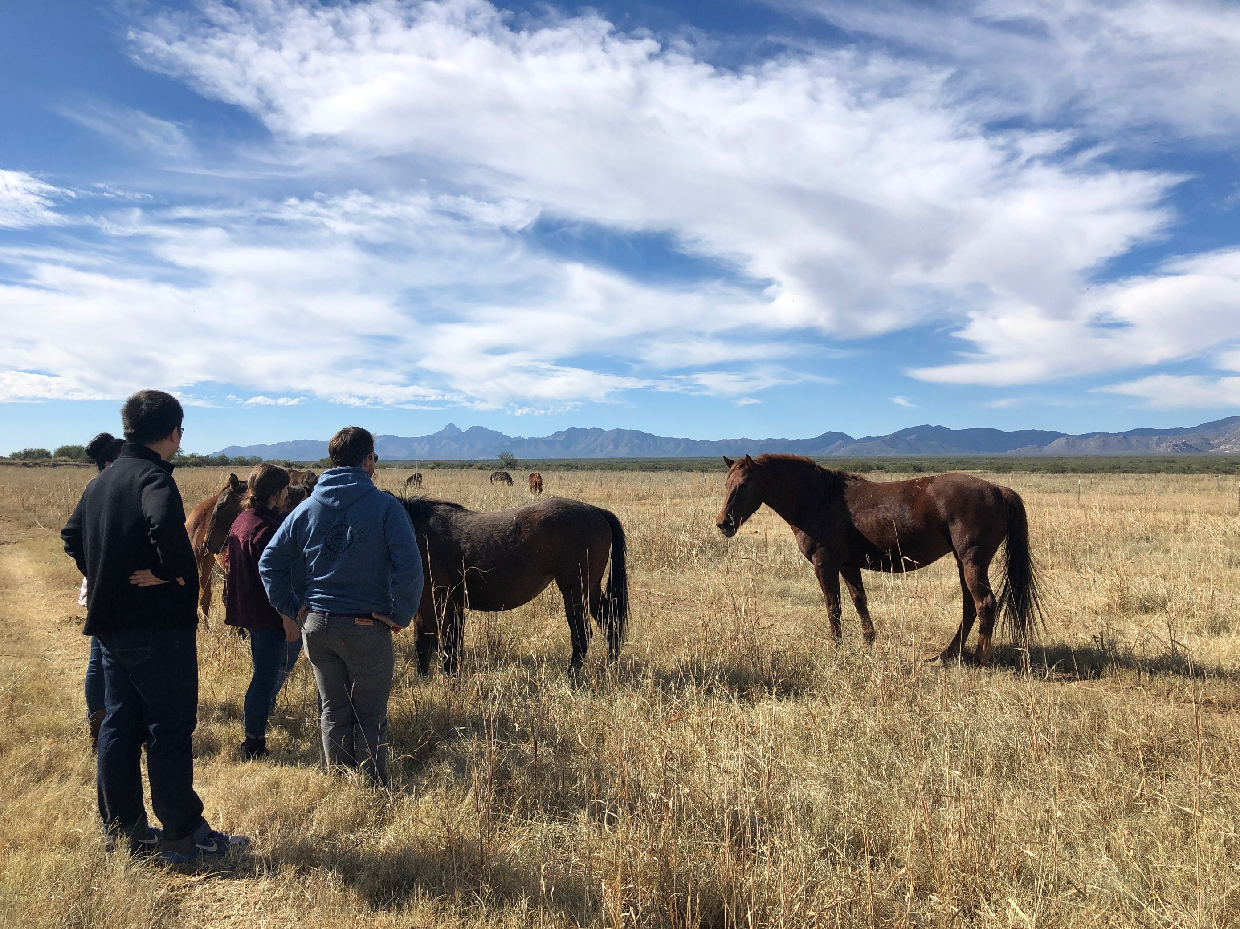
Outside the Classroom – Field Trip to King’s Anvil Ranch

Slide 22
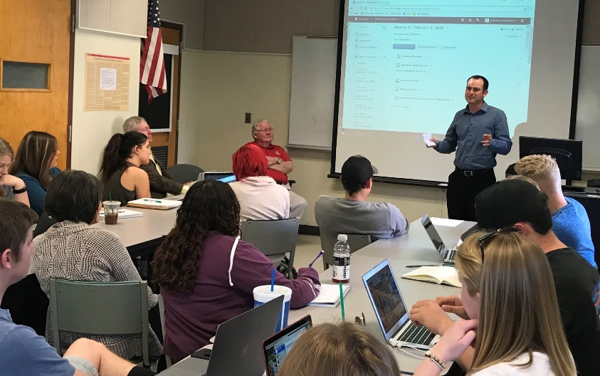
Course Update - ACBS/Law 411 Joint Course - Joe Willis
“An introduction to Agricultural Law and Policy for the Modern Day Natural Resource User”
First class of its kind for undergraduates
Co-taught by Celeste Steen, Esq. and Joe Willis, Esq.
Overall purpose to promote law as a career option to students working on degrees associated with natural resource use

Slide 23
Development Efforts to Date - Jim Davis and Karen Hollish

Slide 24
AB Member Expertise Directory & Communications - Barbara Hutchinson & Sheila Merrigan
Plans for an Advisory Board member expertise directory:
Action: Please send your bio/resume to Barb and Sheila (barbarah@cals.arizona.edu merrigan@cals.arizona.edu)
Communication outlets:
Website: https://extension.arizona.edu/nrulpc
Newsletter: https://extension.arizona.edu/nrulpc-newsletter-other-resources
Listservs for 1) Advisory Board & 2) AB+ interested persons

Slide 25
AB Member Expertise Directory
NRULPC Advisory Board Member Expertise Directory - Template
Name | Date Joined | Yr Rotation | Bio y/n | Newsletter | Expertise | Affiliation | Email Addresses
*Groseta, Andy | 2016 |  | Yes | Vol. 1, No. 2 |  |  | wdartranch@qwestoffice.net
Lacy, John | 2016 |  | No | Vol. 1, No. 1 |  |  | jlacy@dmyl.com jlacy@email.arizona.edu
Ruyle, George | 2016 |  | No | Vol. 1, No. 1 |  |  | Gruyle@cals.arizona.edu
Sullivan, Bethany |  |  |  |  |  |  | bcsull@email.arizona.edu
*Willis, Joe | 2016 |  | Yes | Vol. 1, No. 2 |  |  | jwillis@schwabe.com LSchauer@schwabe.com
*Bingham, Matt | 2016 |  | Yes | Vol. 2, No. 1 |  |  | Matt.bingham@hudbay.com

Slide 26
Other Future Plans - Joe Willis, Advisory Board Chair & Andy Groseta, Advisory Board Vice-Chair
E-poll will be sent after the meeting to indicate
willingness to continue to serve on the NRULPC Advisory Board
term preference
Face-to-face meeting in January/February 2019
will send out Doodle poll to determine date
PPT Slides will be available on the NRULPC website
Plans for NRULPC marketing video
E-Poll DRAFT
Please indicate your interest in continuing to serve on the NRULPC Advisory Board:
Yes No
Please indicate the term level you prefer, with potential for consecutive terms (we are hoping to have different levels selected to allow for rotation)
One year (2019)
Two years (2019-2020)
Three years (2019-2021)
Other Comments/Questions

Slide 27
Comments/questions/suggestions - Joe Willis & Andy Groseta
Guiding Question: How do you feel the Advisory Board could be most productively engaged with the NRULPC/Clinic?
Role of Advisory Board
Meetings of the Advisory Board
Outreach Activities of the Advisory Board Members

Slide 28
Guiding Question: How do you feel the Advisory Board could be most productively engaged with the NRULPC/Clinic?
Role of Advisory Board:
To provide guidance to the NRULPC leadership on important natural resource issues, advocacy for community service and student programs and projects, and to assist in fund-raising, the Advisory Board is composed of representatives from a variety of segments of the natural resource community. To this end, the Advisory Board provides expert advice on natural resource issues and matters undertaken to support stakeholder requests as appropriate. In addition, Advisory Board members help to identify and approach funding sources that will continue to build the capacity of the Center to provide pro bono services to underrepresented natural resource users.

Slide 29
Guiding Question: How do you feel the Advisory Board could be most productively engaged with the NRULPC/Clinic?
Role of Advisory Board – suggestions?
Responses:
Richard – I am not clear about how AB members will share in evaluations of clinic matters and center projects;
also will Clinic take on contract research? (not generally a model for Clinics, but more likely in Center – John – can grow out of Clinic programs)
Bethany – weighs student interests against issues that is more of an internal screening; but projects come from suggestions from others
George – perhaps need to develop a mechanism to involve AB more specifically; a discussion for in-person meeting
Stephanie – it might be valuable to have a process for AB to discuss those issues and how planning out and affecting users; helpful to decision-makers
Bethany – Clinic projects have a tight timeline so decisions have to be made quickly; but will look at how to build into regular meetings. Has to be sensitive to confidentiality issues.

Slide 30
Guiding Question: How do you feel the Advisory Board could be most productively engaged with the NRULPC/Clinic?
Meetings of the Advisory Board:
At least two Advisory Board meetings will be held per year. One of these will be in-person and will be located in either Tucson or Phoenix. Additional meetings will be virtual using teleconferencing services allowing for visual presentations and open discussions. Meetings will include updates on NRULPC educational and outreach programs, development activities and status, and discussions on topics of broad interest to the natural resource community.

Slide 31
Guiding Question: How do you feel the Advisory Board could be most productively engaged with the NRULPC/Clinic?
Meetings of the Advisory Board – suggestions?
Responses:
Jeff – in person meeting twice a year would be helpful; student in animal sciences wants to go to Law School; meetings could be used for recruitment
Joe – students did come to first in person meeting and they did benefit
Richard – the AB may need to develop a committee structure
Stef – having meetings in Phx and Tucson would be helpful
Jeff – if Safford, could include mining and ranchers there

Slide 32
Guiding Question: How do you feel the Advisory Board could be most productively engaged with the NRULPC/Clinic?
Outreach Activities of the AB Members:
Advisory Board members may be called upon to provide information about themselves and/or related activities that will be disseminated through the NRULPC communications outlets. They may also be asked to review content prior to publication.

Slide 33
Guiding Question: How do you feel the Advisory Board could be most productively engaged with the NRULPC/Clinic?
Outreach Activities of the AB Members – comments?
Responses:
Stef – can we have a tag for email as to whether they are about issues, Clinic, Center etc. – id action items – Headings need to be clear.
Sandy – how does Clinic incorporate different perspectives of the users related to the issues presented; can AB provide that input prior to presentations?
Bethany – wants to have students hear as many different perspectives as possible with implications for people in the community. This takes place in classroom and in the field. She would be happy to hear ideas.
Sandy – happy to hear that; hope that presentations will show multiple perspectives.
Joe – had a waiting list for students to take course; now has a room for 40 people. Ag-Law course shows link between policy and practice, and differences of opinion, but the law is more definite.
John – good ties throughout UA to present a balanced approach
Allison – is there an opportunity for publications outside class work; blog for natural resource users. – Bethany – the blog format could work well for students and is a possibility. Needs to think about how to hone in on specific topics.
Ashley – basic questions – what are my rights to water; not just litigation – this could be a great resource for users rather than going to law firms. Hot topics in AZ law – romaine lettuce etc. Maryland and Texas has this. Here are facts, here are laws. May want to look at some individual law firms. Stef also agrees with this. Bethany will explore this.
Bill Plummer – monthly email divided into three areas: status of litigation; key policy issues being considered at state level – will need to look at how to do this along with blog and newsletter.
Ashley – likes blog idea; and sign up for weekly email with blog postings.
Bethany – wants to consider how to gain input from AB on what are the hot topics
John – we are looking at AB to get advice and information because you represent diverse interests. This really helps us id new areas. Joe – feels other organizations are doing some of this and could be used to provide some of this information.
Ashley has offered to help.

Slide 34
WE VALUE YOU!
THANK YOU FOR YOUR COMMITMENT TO THE NRULPC and CLINIC!

